Slide 1
Information Extraction
Adapted from: Chris Callison-Burch, Tom Mitchell

Slide 2
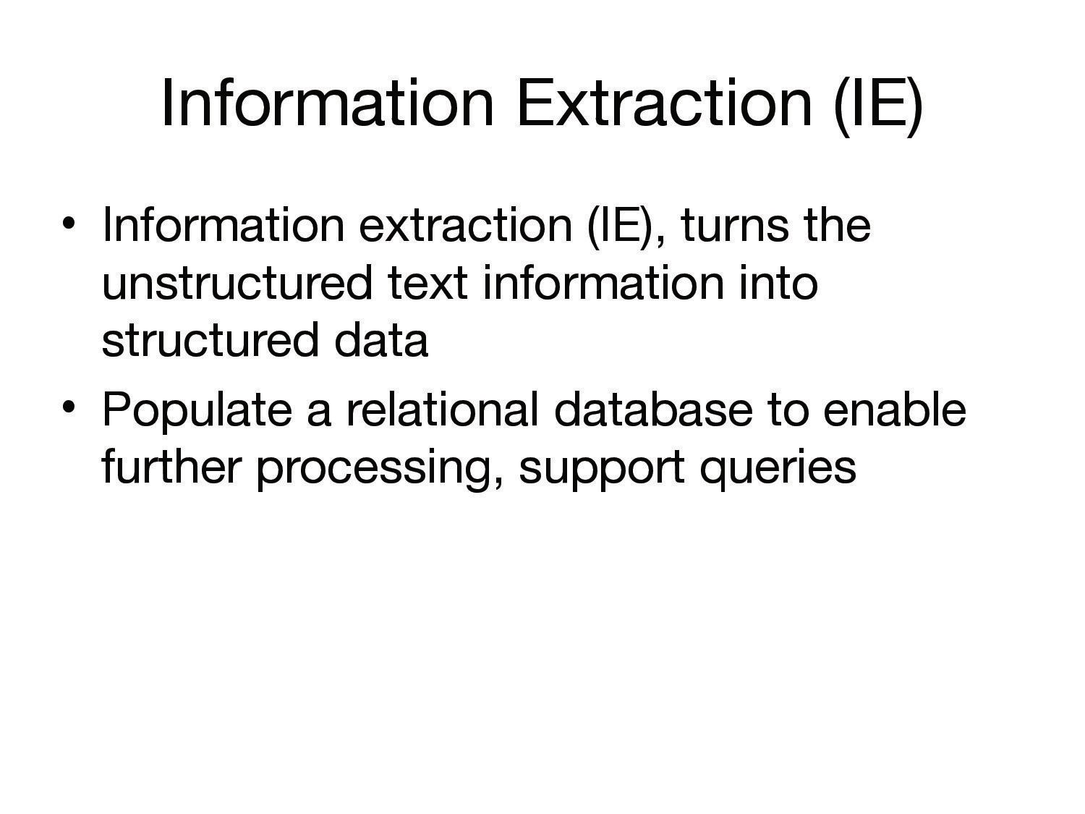

Slide 3
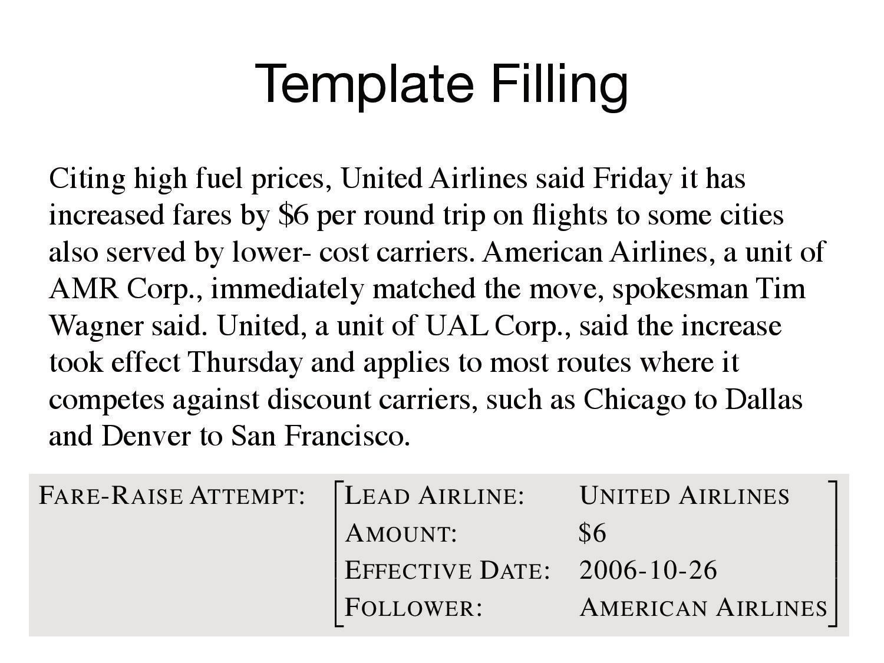

Slide 4
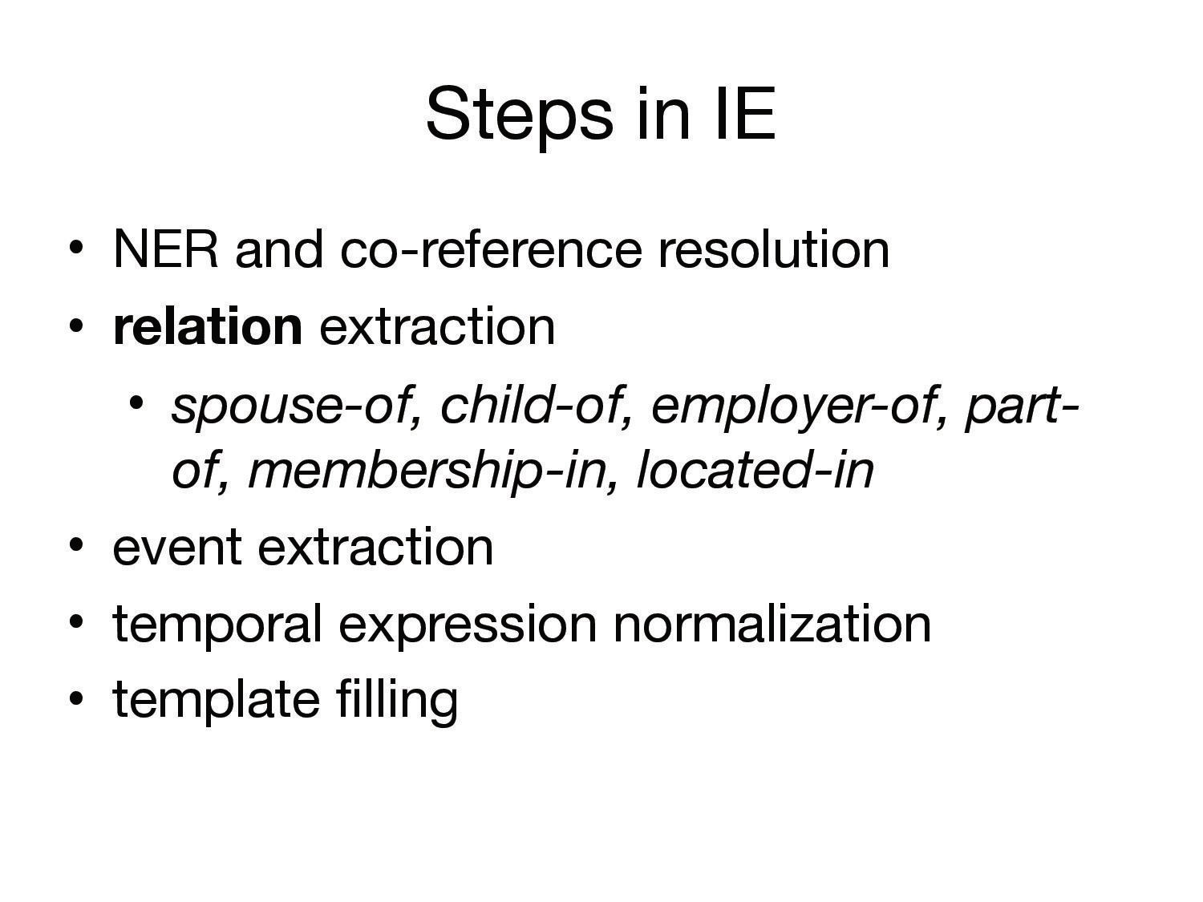

Slide 5
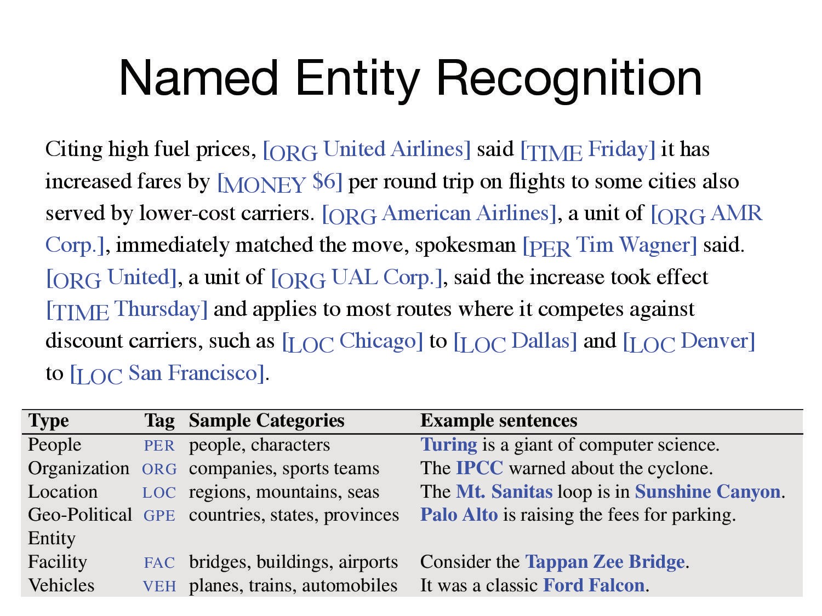

Slide 6
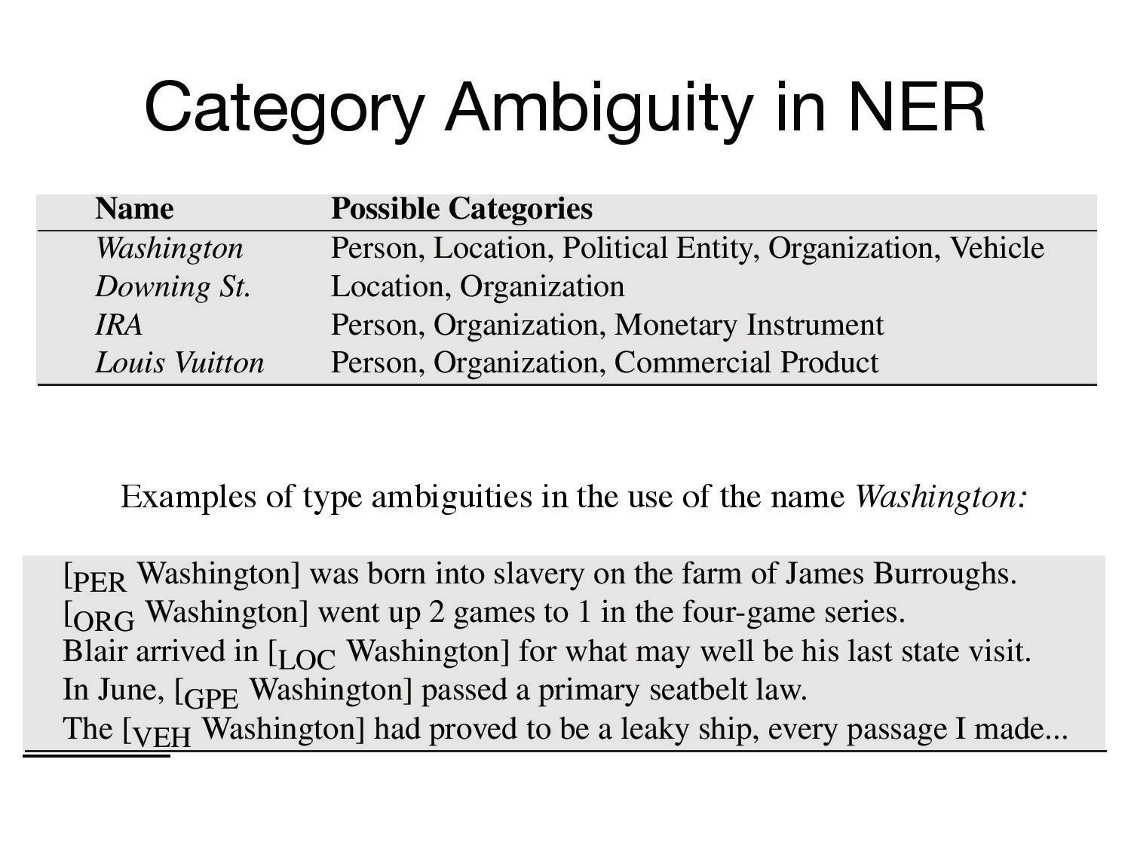

Slide 7
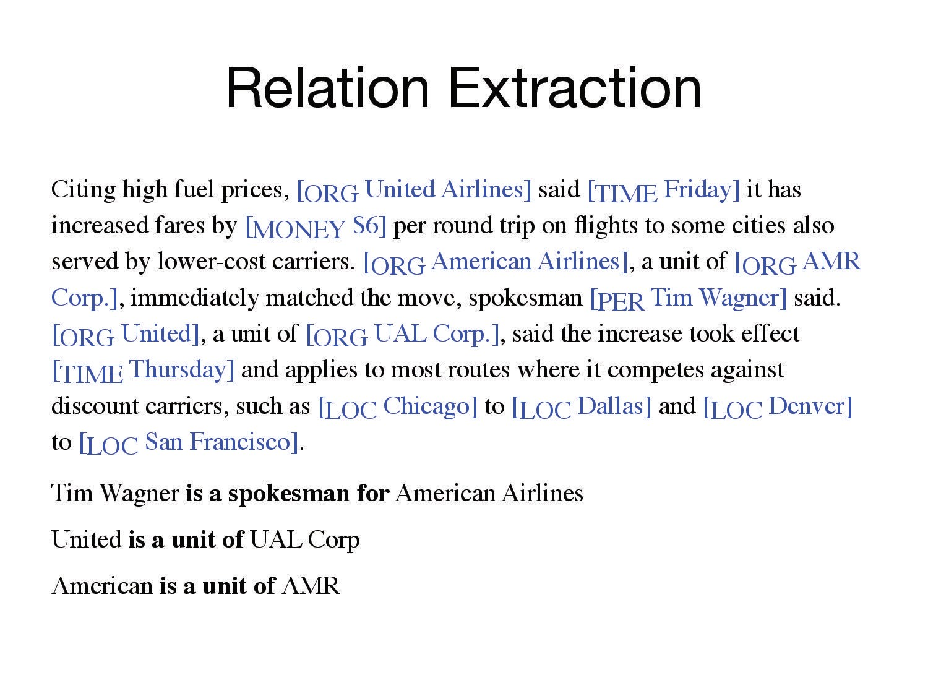

Slide 8
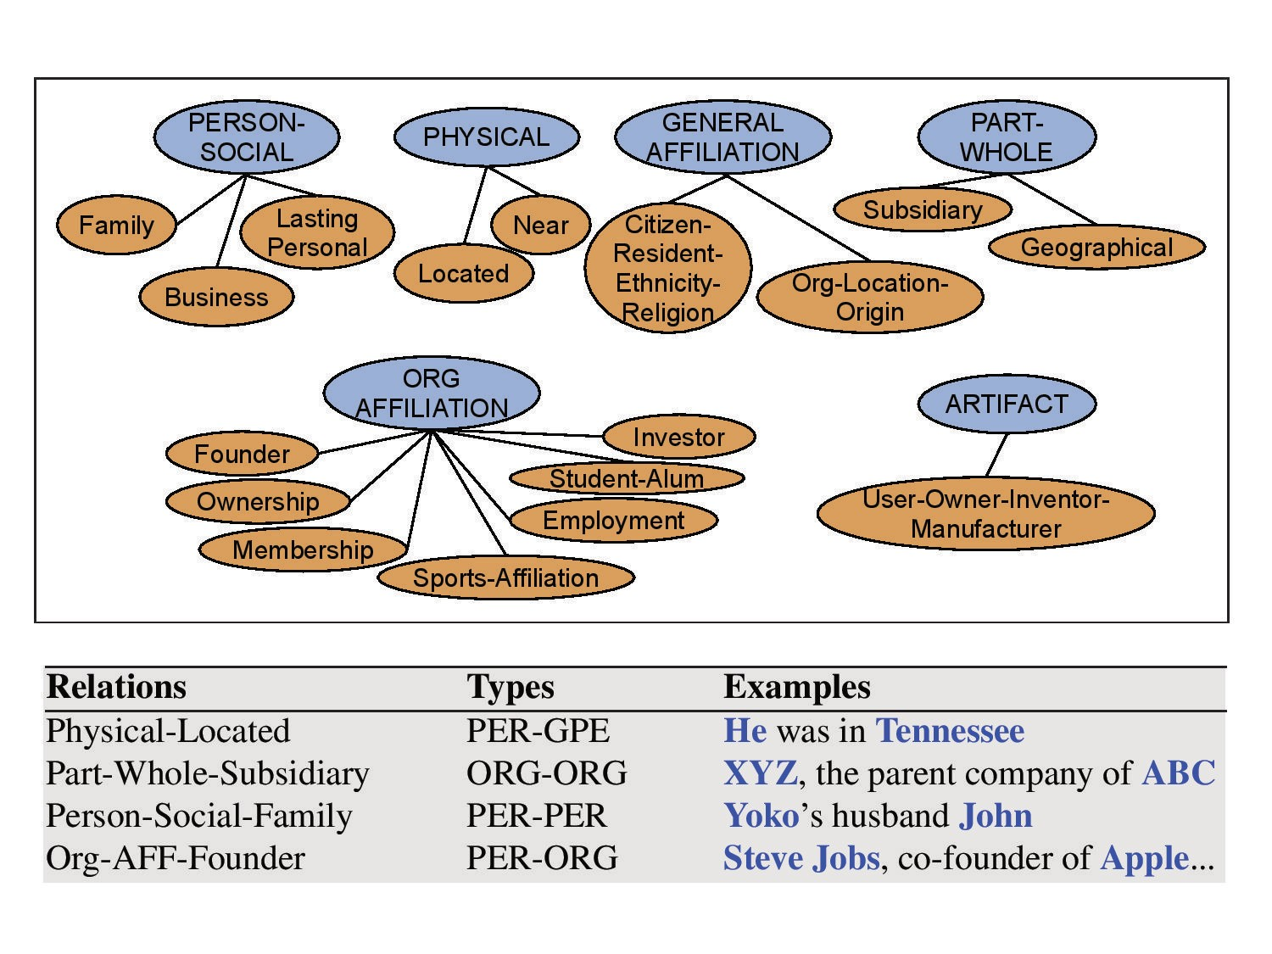

Slide 9
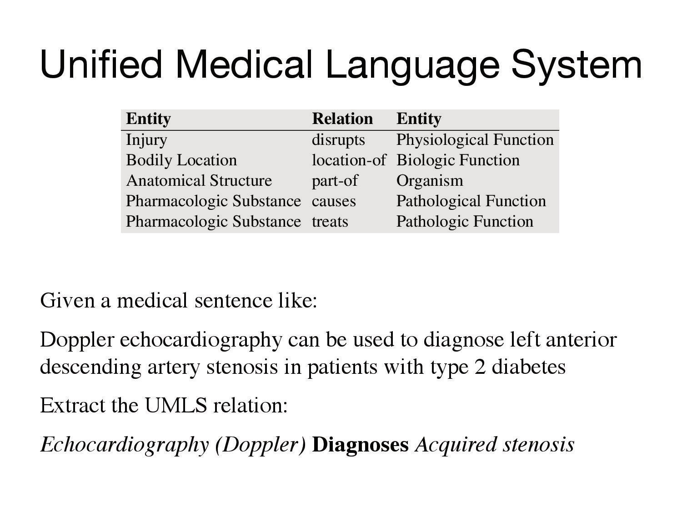

Slide 10
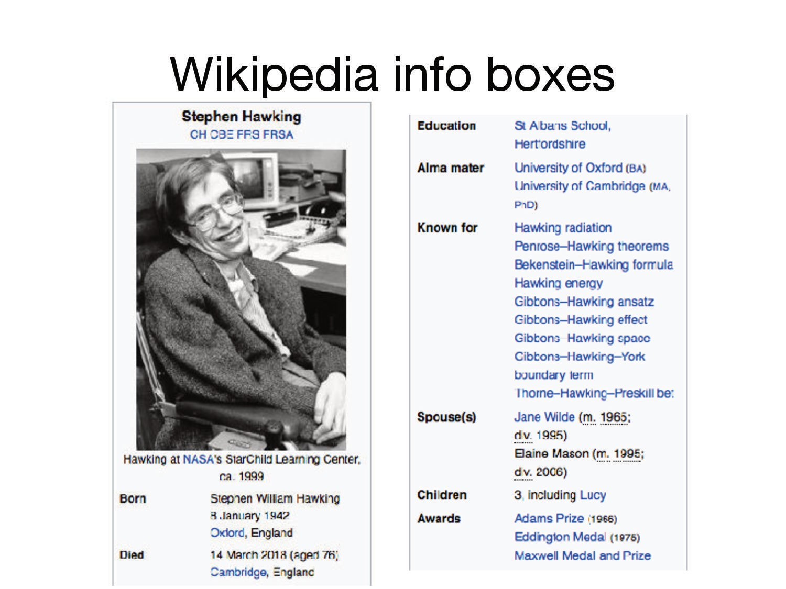

Slide 11
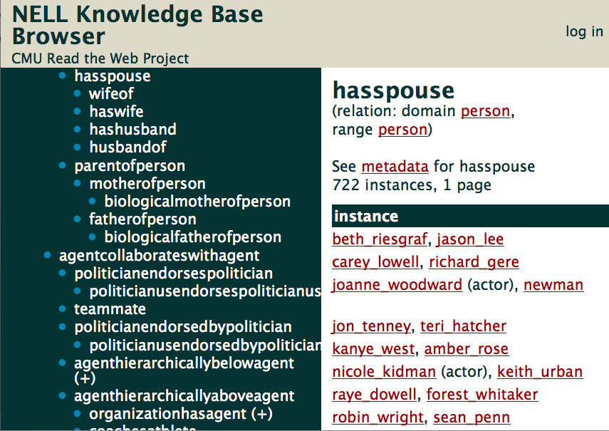
Natural Language Understanding (NLU)
text
Nicole Kidman
married
Keith Urban.
knowledge base
hasspouse
nicole_kidman
keith_urban
Notes:
Going back to machine reading and understanding, what I want to focus in this talk is the task of natural language understanding, which can be formulated in one way as the the task of mapping natural language such as the ones we found in text to its meaning representation: entities and relations in the world.
Some of these entities and relations in the world are already being catalogued by humans in the ontologies found in knowledge bases such as NELL
Therefore, one of the way we can do natural language understanding is by mapping natural language text to entities and relations in the knowledge bases.

Slide 12
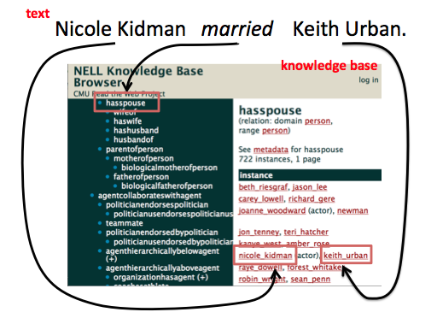

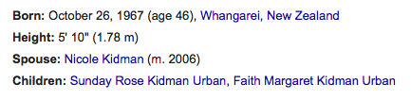
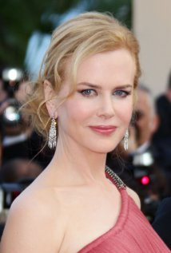
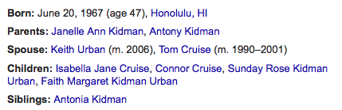
Incorporating KBs for NLU
Keith Urban (male)
Nicole Kidman (female)
Nicole Kidman married Keith Urban.
She has two daughters with him.
Notes:
There are several advantages to incorporating knowledge in knowledge bases into language understanding algorithms. One important advantage is that it provides a way of tapping into the knowledge that is available in the knowledge bases; which is not necessarily stated in the text.
By linking text to the knowledge base, we have access to more information about the relation and entities than what are expressed in text.
Such background knowledge can be useful for natural language understanding. For example, we can do inference over the knowledge base to resolve ambiguities.
Previous work on PP attachment disambiguation for example, has shown that tapping into the knowledge in the knowledge bases can improve the performance of the disambiguation

Slide 13
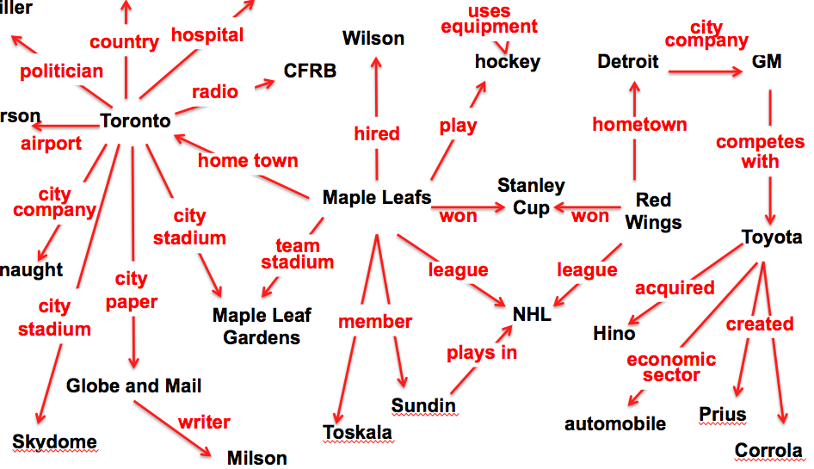
Inference over KB
If:
x1
competes with (x1,x2)
x2
economic sector (x2, x3)
x3
Then:
economic sector (x1, x3)
Notes:
We can also do inference over the knowledge in the knowledge base, for example, to infer that if company x1 and x2 compete with each other and we know the economic sector of one, we can infer the economic sector of the other.

Slide 14
Inference over KB by Random Walks
KB:
Target Relation R:
economic sector (x1, x3)
Random walk
path type:
x1
competes with
x2
economic sector
x3
Infer P (R(x, y)):
Trained logistic function for R, where i^{th} feature is probability of arriving at node y when starting at node x, and taking a random walk along path type i
Ni Lao et al, EMNLP 2011
Notes:
One of the ways we can learn this inference rule is by treating these rules as path types in the knowledge base that connect entities which are instances of the relation of the target relation.
So train a logistic function for the relation, where the i^{th} feature is probability of arriving at node y when starting at node x, and taking a random walk along path type i

Slide 15
CityLocatedInCountry(Pittsburgh) = ?
Pittsburgh
Logistic Regresssion Weight
Feature = Typed Path
CityInState, CityInstate⁻¹, CityLocatedInCountry 0.32
Feature Value
Ni Lao et al, EMNLP 2011

Slide 16
CityLocatedInCountry(Pittsburgh) = ?
Pennsylvania
CityInState
Pittsburgh
Logistic Regresssion Weight
Feature = Typed Path
CityInState, CityInstate⁻¹, CityLocatedInCountry 0.32
Feature Value
Ni Lao et al, EMNLP 2011

Slide 17
CityLocatedInCountry(Pittsburgh) = ?
Pennsylvania
CityInState
CityInState⁻¹
CityInState⁻¹
…(14)
Pittsburgh
Philadelphia
Harisburg
Logistic Regresssion Weight
Feature = Typed Path
CityInState, CityInstate⁻¹, CityLocatedInCountry 0.32
Feature Value
Ni Lao et al, EMNLP 2011

Slide 18
CityLocatedInCountry(Pittsburgh) = ?
Pennsylvania
U.S.
CityInState
CityInState⁻¹
CityLocatedInCountry
CityInState⁻¹
…(14)
Pittsburgh
Philadelphia
Harisburg
Logistic Regresssion Weight
Feature = Typed Path
CityInState, CityInstate⁻¹, CityLocatedInCountry 0.32
Feature Value
Ni Lao et al, EMNLP 2011

Slide 19
CityLocatedInCountry(Pittsburgh) = ?
Pennsylvania
U.S.
CityInState
CityInState⁻¹
CityLocatedInCountry
CityInState⁻¹
…(14)
Pittsburgh
Philadelphia
Harisburg
Pr(U.S. | Pittsburgh, TypedPath)
Logistic Regresssion Weight
Feature = Typed Path
CityInState, CityInstate⁻¹, CityLocatedInCountry 0.8 0.32
Feature Value
Ni Lao et al, EMNLP 2011

Slide 20
CityLocatedInCountry(Pittsburgh) = ?
Pennsylvania
U.S.
CityInState
CityInState⁻¹
CityLocatedInCountry
CityInState⁻¹
…(14)
Pittsburgh
Philadelphia
Harisburg
Logistic Regresssion Weight
Feature = Typed Path
CityInState, CityInstate⁻¹, CityLocatedInCountry 0.8 0.32
AtLocation⁻¹, AtLocation, CityLocatedInCountry 0.20
Feature Value
Ni Lao et al, EMNLP 2011

Slide 21
CityLocatedInCountry(Pittsburgh) = ?
Pennsylvania
U.S.
CityInState
CityInState⁻¹
CityLocatedInCountry
CityInState⁻¹
…(14)
Pittsburgh
Philadelphia
Harisburg
AtLocation⁻¹
PPG
Delta
Logistic Regresssion Weight
Feature = Typed Path
CityInState, CityInstate⁻¹, CityLocatedInCountry 0.8 0.32
AtLocation⁻¹, AtLocation, CityLocatedInCountry 0.20
Feature Value
Ni Lao et al, EMNLP 2011

Slide 22
CityLocatedInCountry(Pittsburgh) = ?
Pennsylvania
U.S.
CityInState
CityInState⁻¹
CityLocatedInCountry
CityInState⁻¹
…(14)
Pittsburgh
Philadelphia
Harisburg
AtLocation⁻¹
Atlanta
Dallas
AtLocation
Tokyo
PPG
Delta
Logistic Regresssion Weight
Feature = Typed Path
CityInState, CityInstate⁻¹, CityLocatedInCountry 0.8 0.32
AtLocation⁻¹, AtLocation, CityLocatedInCountry 0.20
Feature Value
Ni Lao et al, EMNLP 2011

Slide 23
CityLocatedInCountry(Pittsburgh) = ?
Pennsylvania
U.S.
Japan
CityInState
CityInState⁻¹
CityLocatedInCountry
CityInState⁻¹
…(14)
CityLocatedInCountry
Pittsburgh
Philadelphia
Harisburg
AtLocation⁻¹
Atlanta
Dallas
AtLocation
Tokyo
PPG
Delta
Logistic Regresssion Weight
Feature = Typed Path
CityInState, CityInstate⁻¹, CityLocatedInCountry 0.8 0.32
AtLocation⁻¹, AtLocation, CityLocatedInCountry 0.6 0.20
Feature Value
Ni Lao et al, EMNLP 2011

Slide 24
CityLocatedInCountry(Pittsburgh) = ?
Pennsylvania
U.S.
Japan
CityInState
CityInState⁻¹
CityLocatedInCountry
CityInState⁻¹
…(14)
CityLocatedInCountry
Pittsburgh
Philadelphia
Harisburg
AtLocation⁻¹
Atlanta
Dallas
AtLocation
Tokyo
PPG
Delta
Logistic Regresssion Weight
Feature = Typed Path
CityInState, CityInstate⁻¹, CityLocatedInCountry 0.8 0.32
AtLocation⁻¹, AtLocation, CityLocatedInCountry 0.6 0.20
… … …
Feature Value
CityLocatedInCountry(Pittsburgh) = U.S. p=0.58
Ni Lao et al, EMNLP 2011

Slide 25
Random walk inference: learned path types
CityLocatedInCountry(city, country):
8.04 cityliesonriver, cityliesonriver⁻¹, citylocatedincountry
5.42 hasofficeincity⁻¹, hasofficeincity, citylocatedincountry
4.98 cityalsoknownas, cityalsoknownas, citylocatedincountry
2.85 citycapitalofcountry,citylocatedincountry⁻¹,citylocatedincountry
2.29 agentactsinlocation⁻¹, agentactsinlocation, citylocatedincountry
1.22 statehascapital⁻¹, statelocatedincountry
0.66 citycapitalofcountry
.
.
.
7 of the 2985 learned paths for CityLocatedInCountry

Slide 26
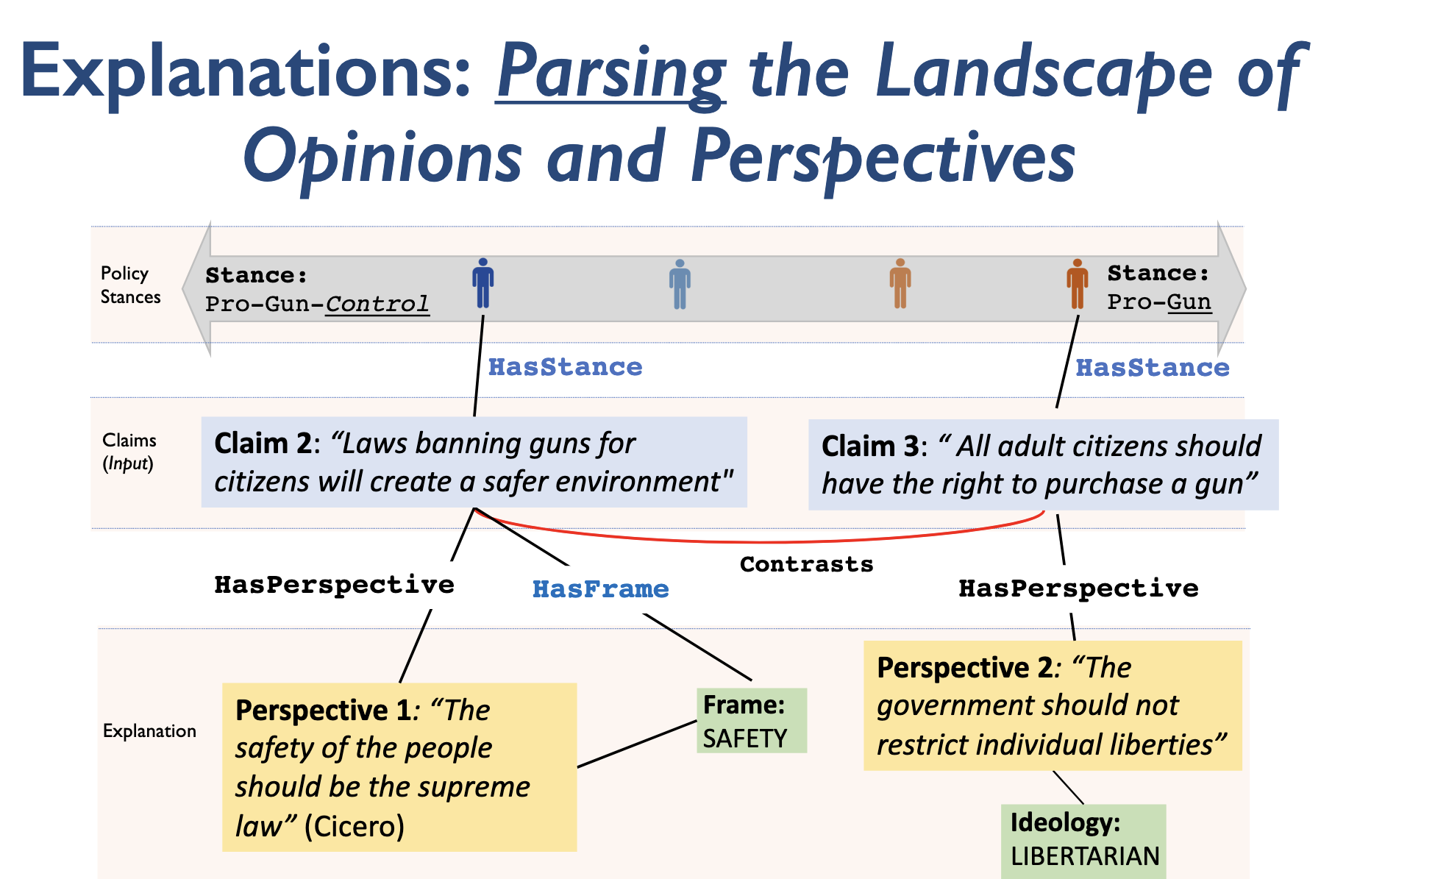
Deep Relational Learning
Pacheco and Goldwaser, 2021
Neuro-symbolic approaches in NLP
https://www.cs.purdue.edu/homes/pachecog/tutorials/ns4nlp/slides.pdf

Slide 27
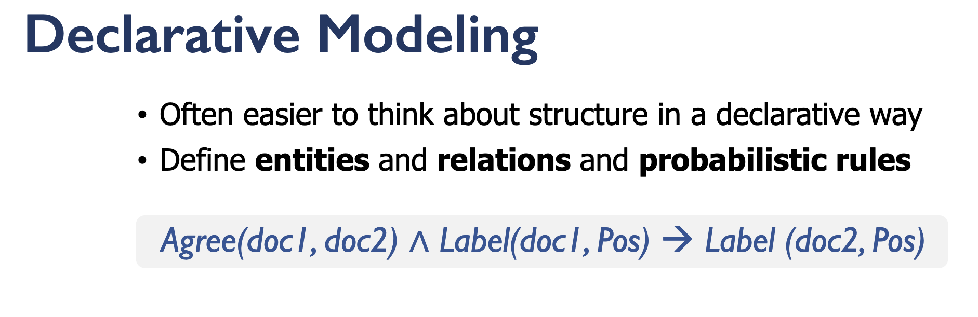
Deep Relational Learning
Pacheco and Goldwaser, 2021
Neuro-symbolic approaches in NLP
https://www.cs.purdue.edu/homes/pachecog/tutorials/ns4nlp/slides.pdf

Slide 28
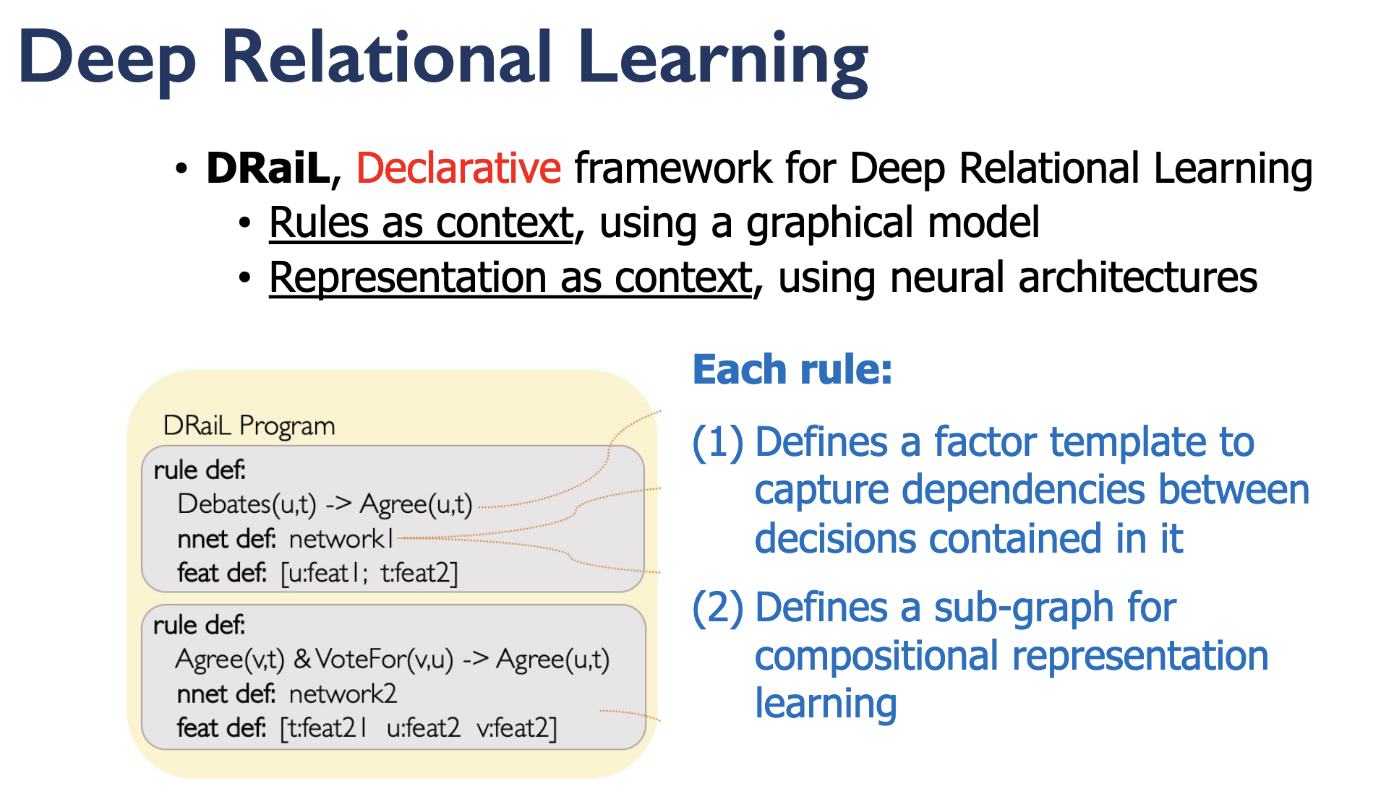
Deep Relational Learning
Pacheco and Goldwaser, 2021
Neuro-symbolic approaches in NLP
https://www.cs.purdue.edu/homes/pachecog/tutorials/ns4nlp/slides.pdf

Slide 29
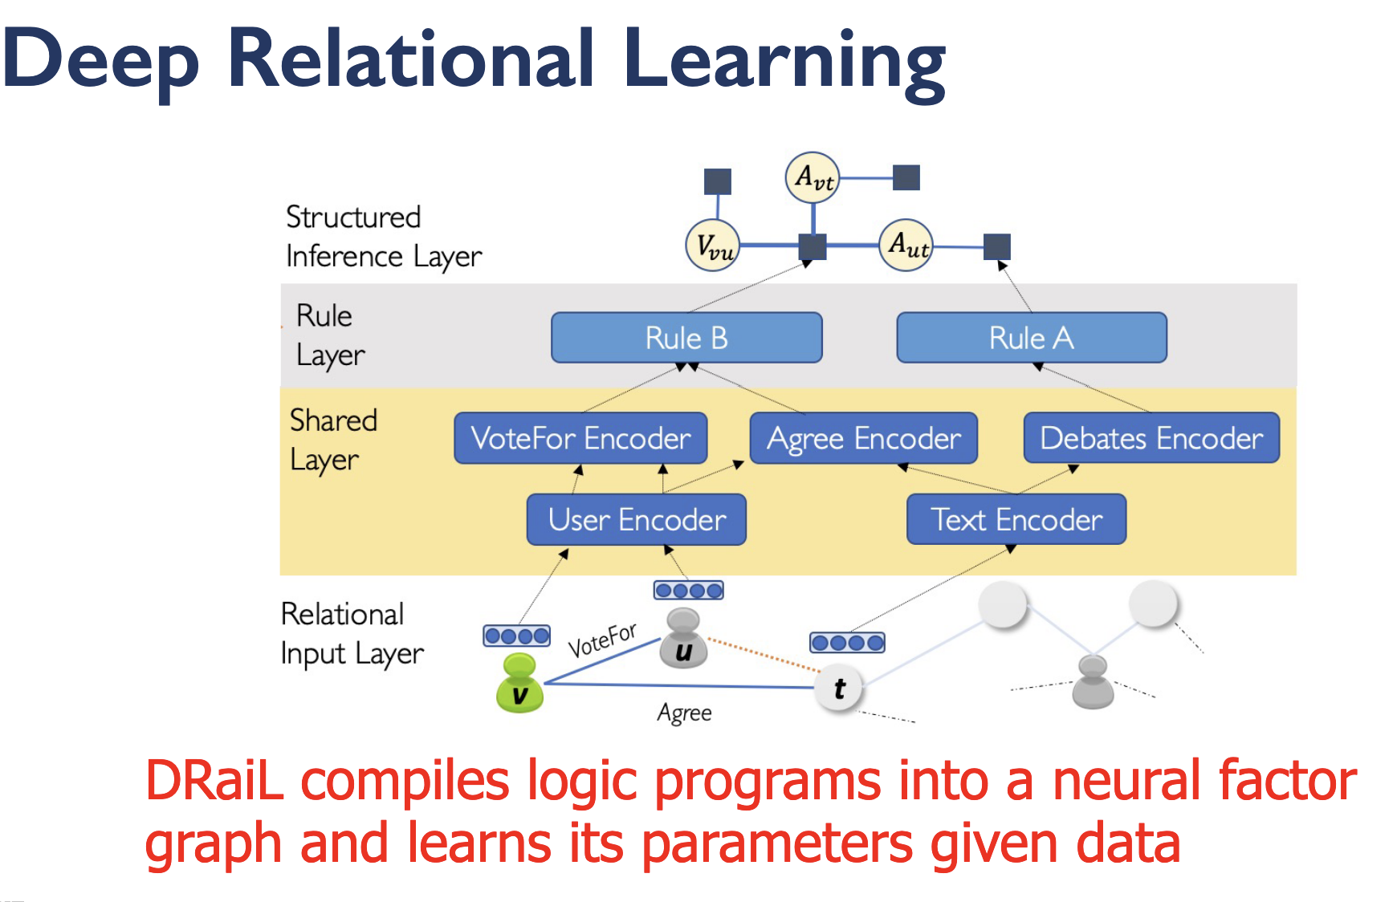
Deep Relational Learning
Pacheco and Goldwaser, 2021
Neuro-symbolic approaches in NLP
https://www.cs.purdue.edu/homes/pachecog/tutorials/ns4nlp/slides.pdf

Slide 30
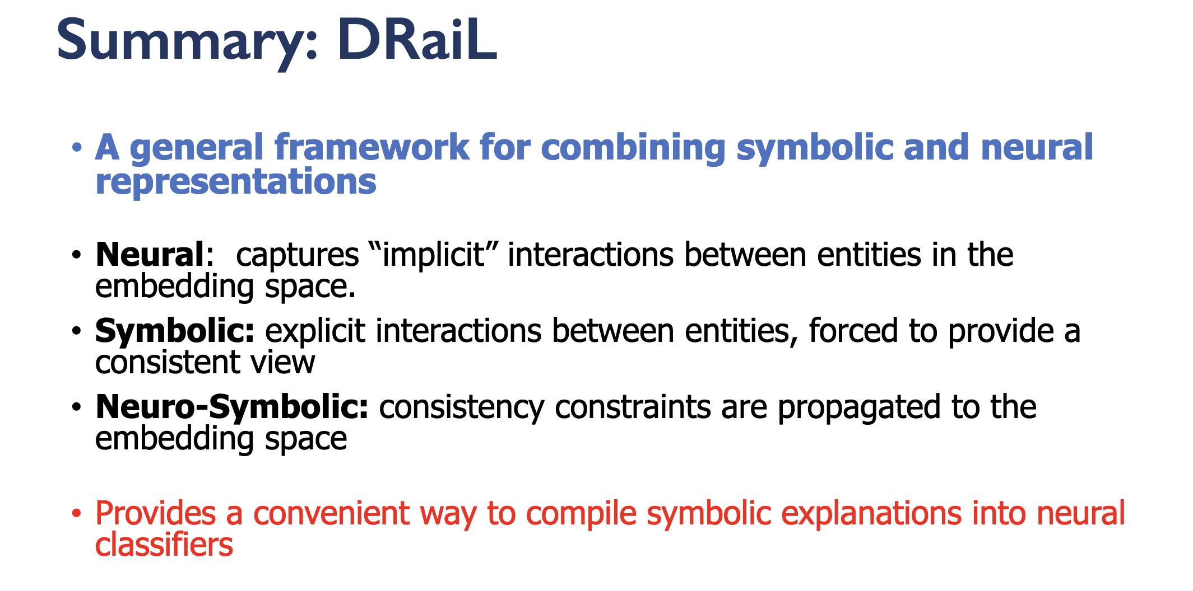
Deep Relational Learning
Pacheco and Goldwaser, 2021
Neuro-symbolic approaches in NLP
https://www.cs.purdue.edu/homes/pachecog/tutorials/ns4nlp/slides.pdf

Slide 31
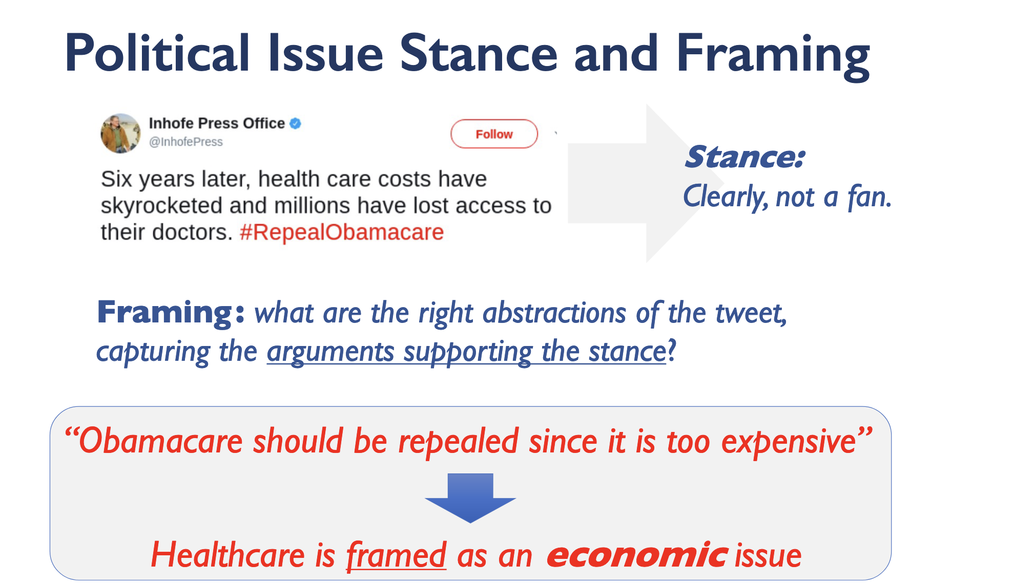
Deep Relational Learning
Pacheco and Goldwaser, 2021
Neuro-symbolic approaches in NLP
https://www.cs.purdue.edu/homes/pachecog/tutorials/ns4nlp/slides.pdf

Slide 32
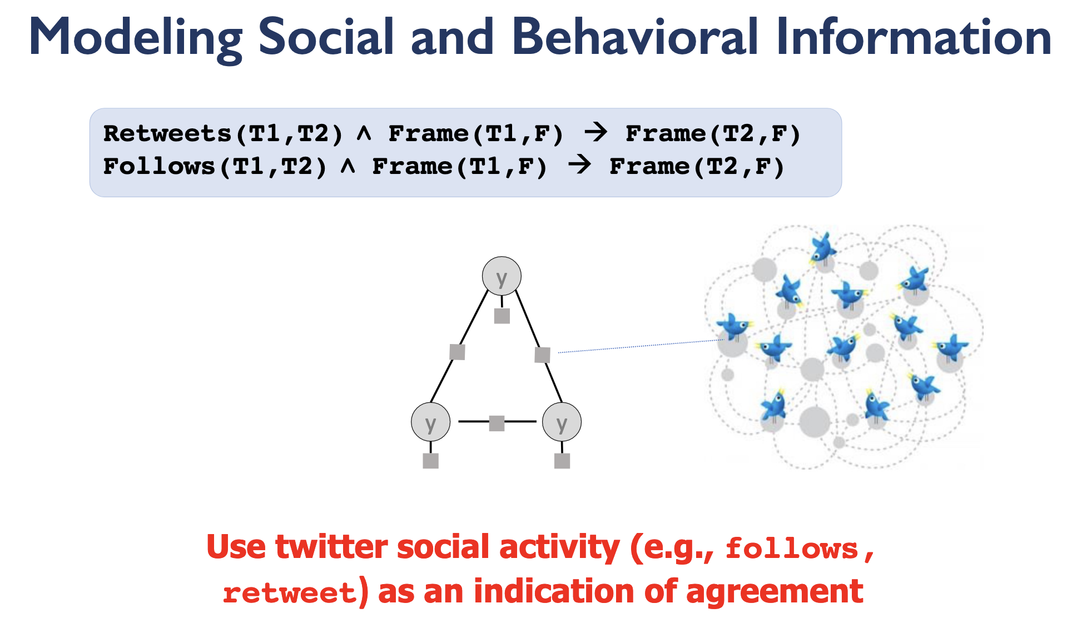
Deep Relational Learning
Pacheco and Goldwaser, 2021
Neuro-symbolic approaches in NLP
https://www.cs.purdue.edu/homes/pachecog/tutorials/ns4nlp/slides.pdf

Slide 33
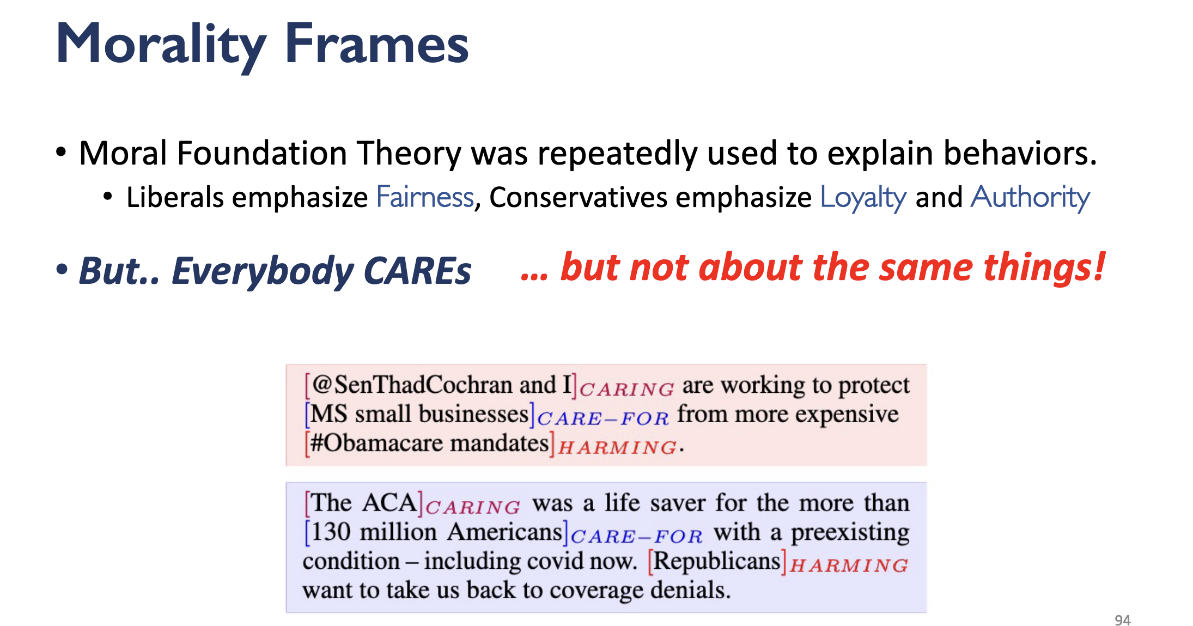
Deep Relational Learning
Pacheco and Goldwaser, 2021
Neuro-symbolic approaches in NLP
https://www.cs.purdue.edu/homes/pachecog/tutorials/ns4nlp/slides.pdf

Slide 34
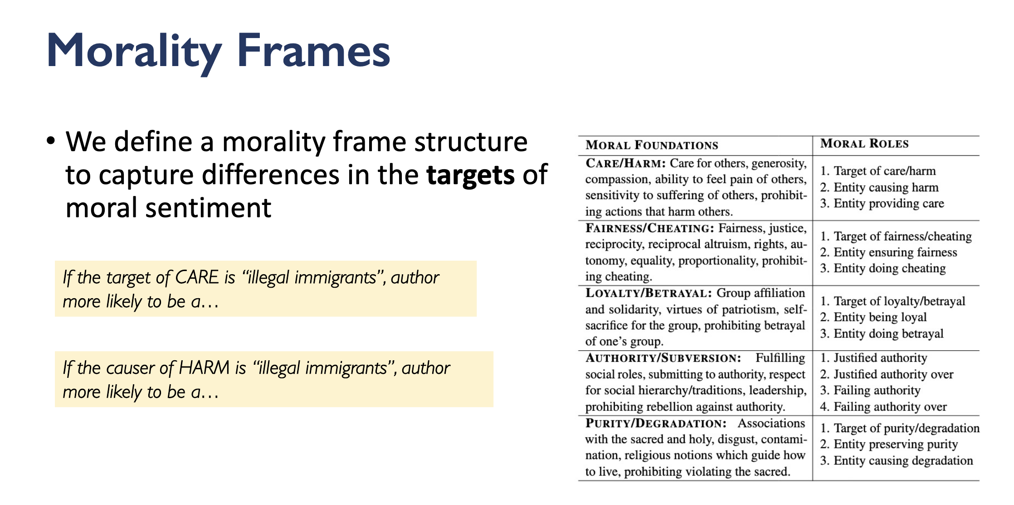
Deep Relational Learning
Pacheco and Goldwaser, 2021
Neuro-symbolic approaches in NLP
https://www.cs.purdue.edu/homes/pachecog/tutorials/ns4nlp/slides.pdf

Slide 35
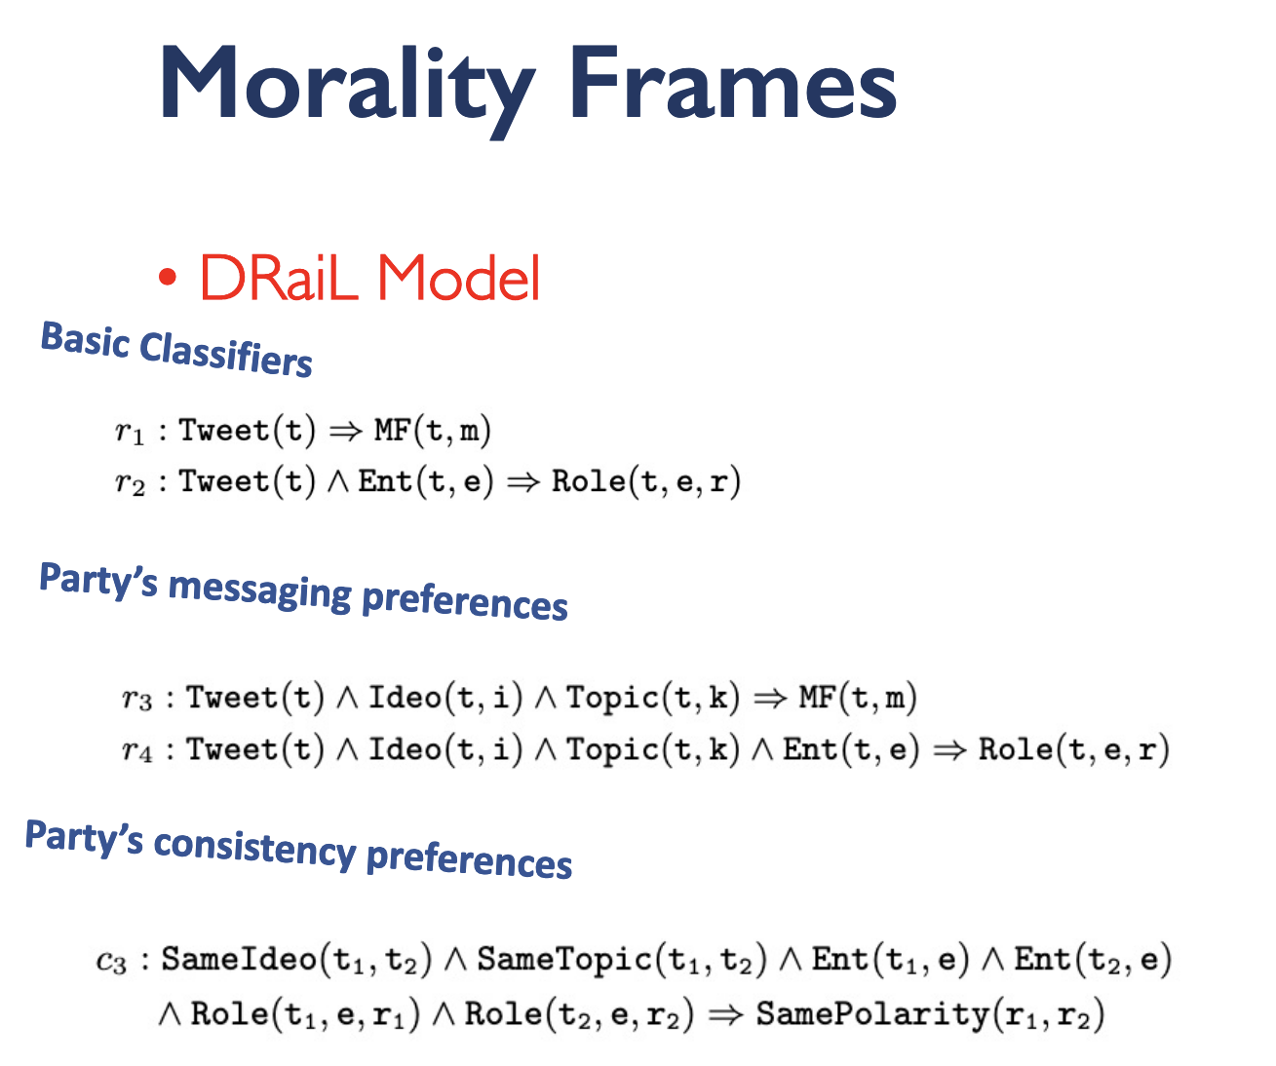
Deep Relational Learning
Pacheco and Goldwaser, 2021
Neuro-symbolic approaches in NLP
https://www.cs.purdue.edu/homes/pachecog/tutorials/ns4nlp/slides.pdf

Slide 36
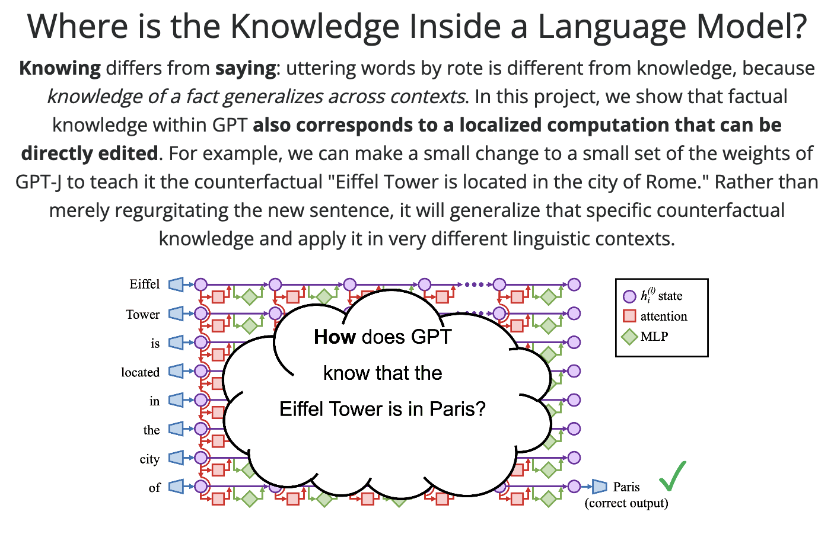
Locating Knowledge in LM
Meng et al., 2022
Locating and Editing Factual Knowledge in GPT
https://rome.baulab.info/

Slide 37
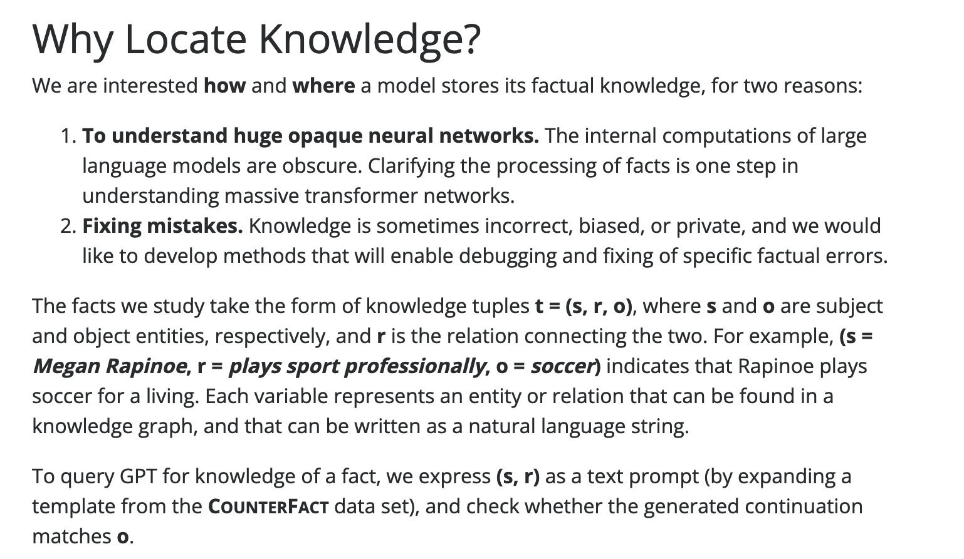
Locating Knowledge in LM
Meng et al., 2022
Locating and Editing Factual Knowledge in GPT
https://rome.baulab.info/

Slide 38
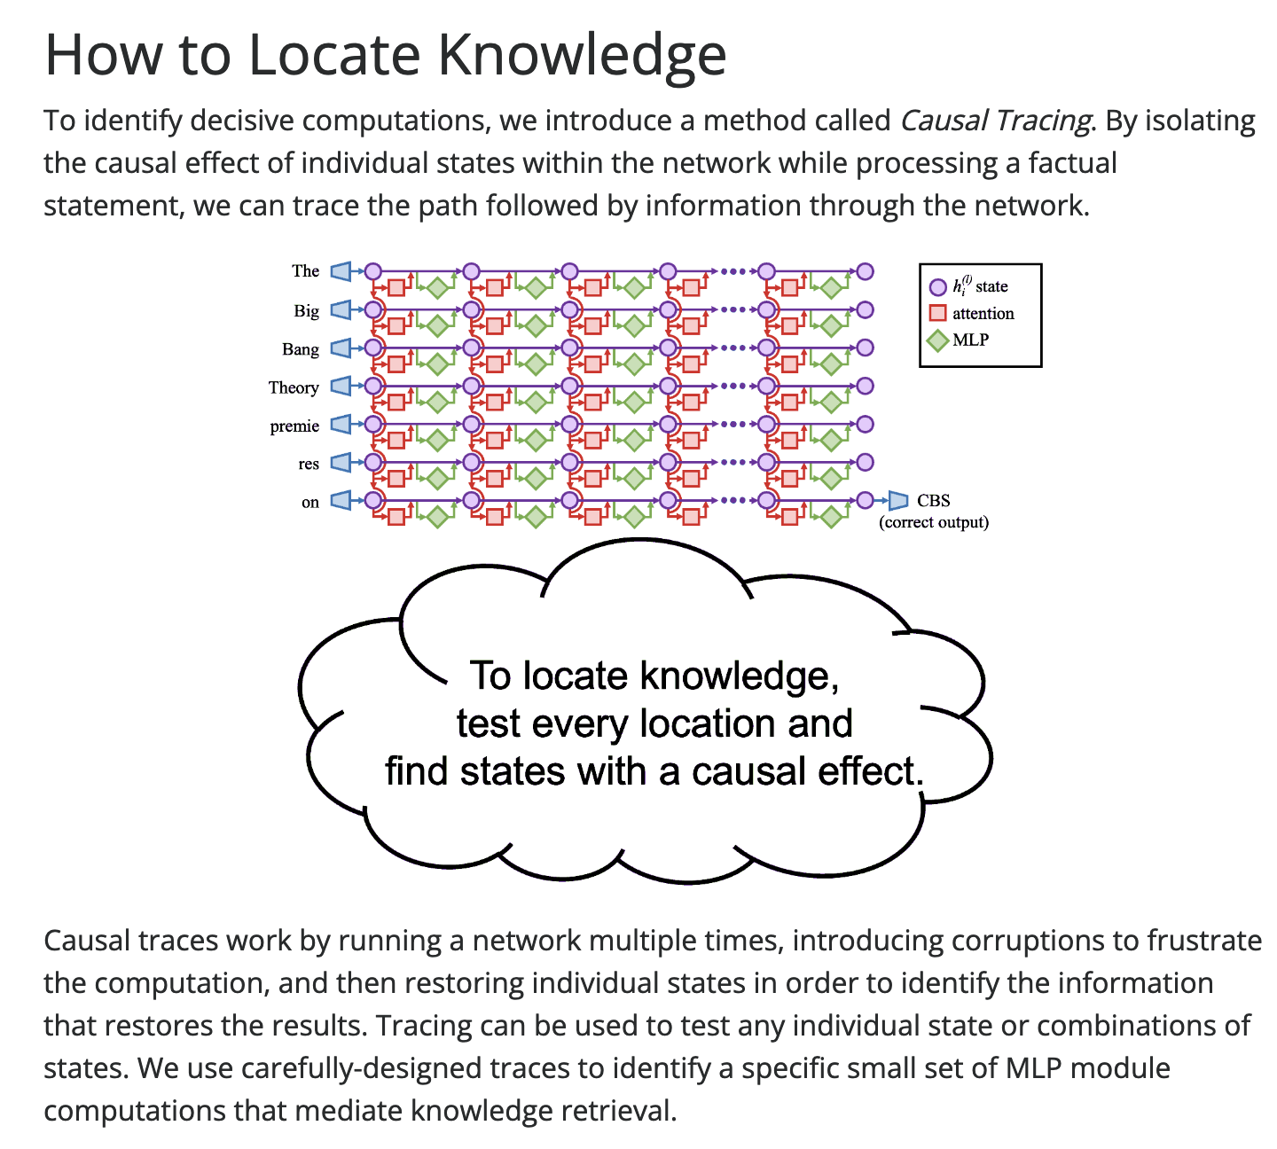
Locating Knowledge in LM
Meng et al., 2022
https://rome.baulab.info/

Slide 39
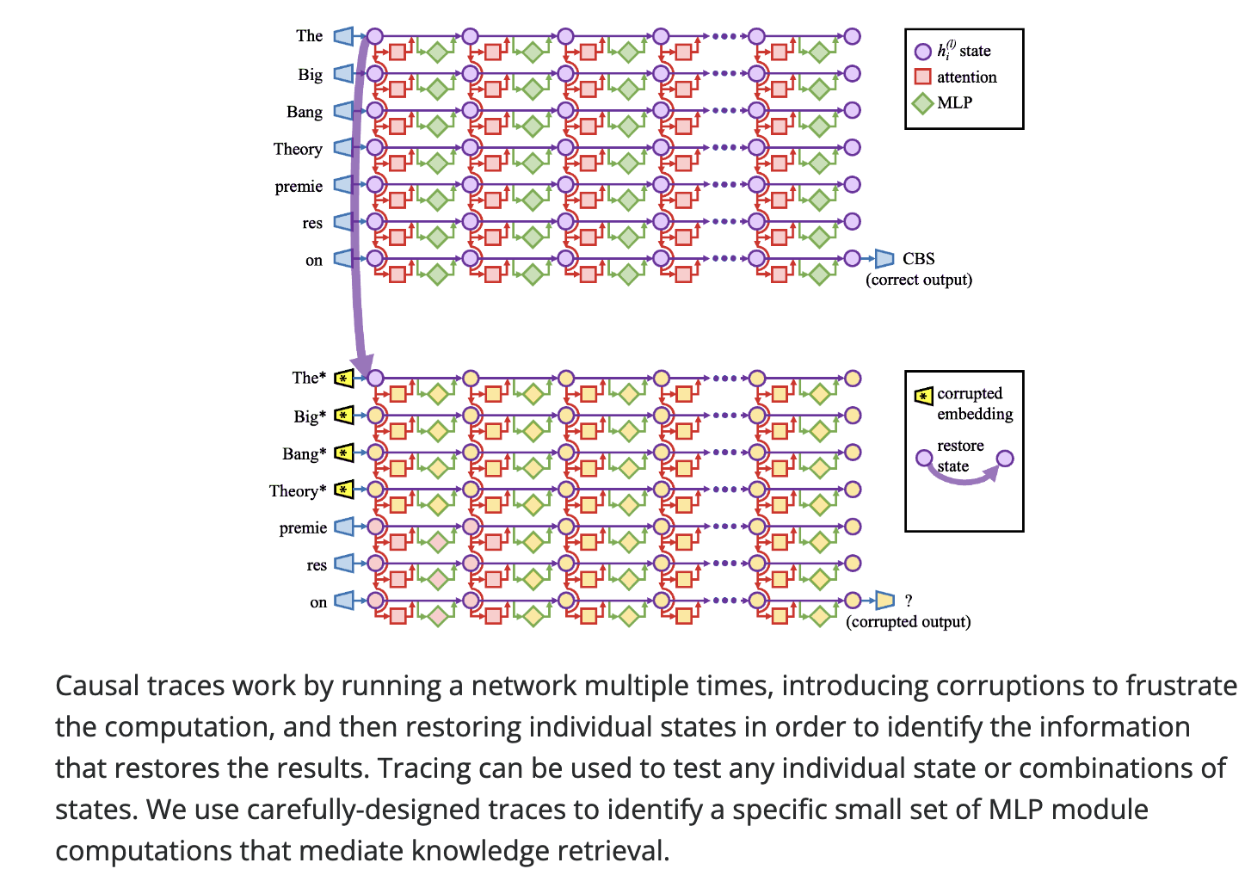
Locating Knowledge in LM
Meng et al., 2022
https://rome.baulab.info/

Slide 40
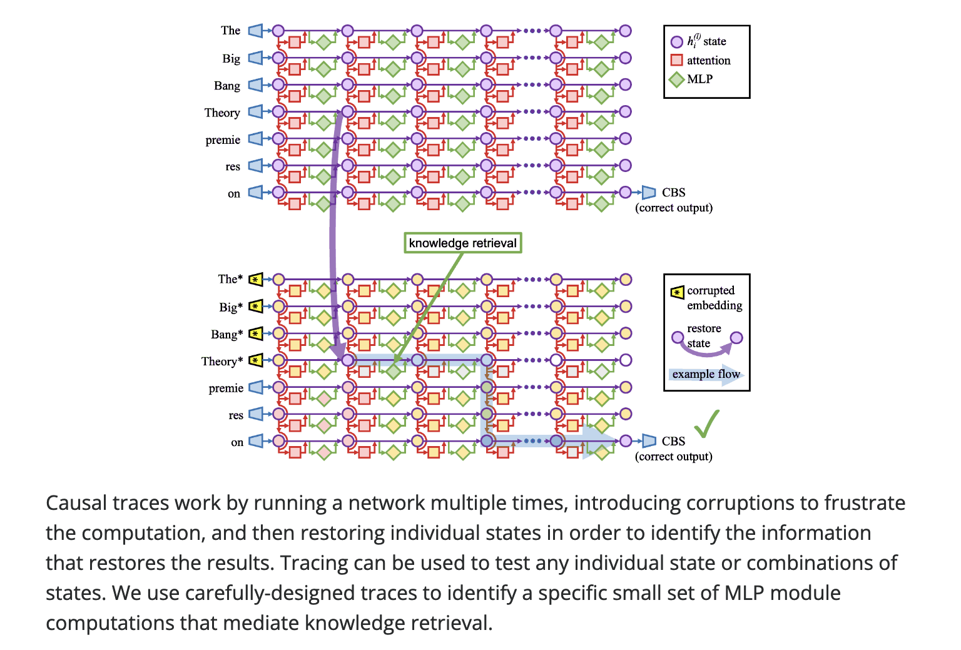
Locating Knowledge in LM
Meng et al., 2022
https://rome.baulab.info/

Slide 41
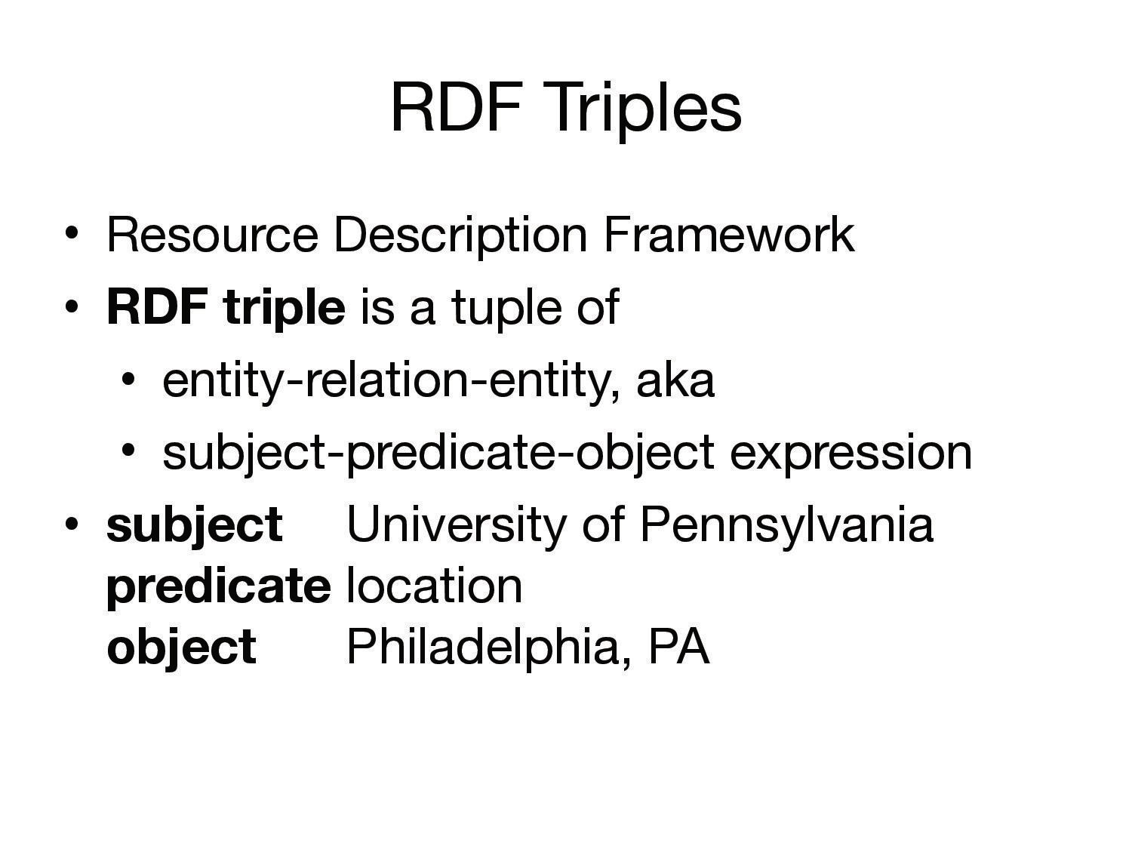

Slide 42
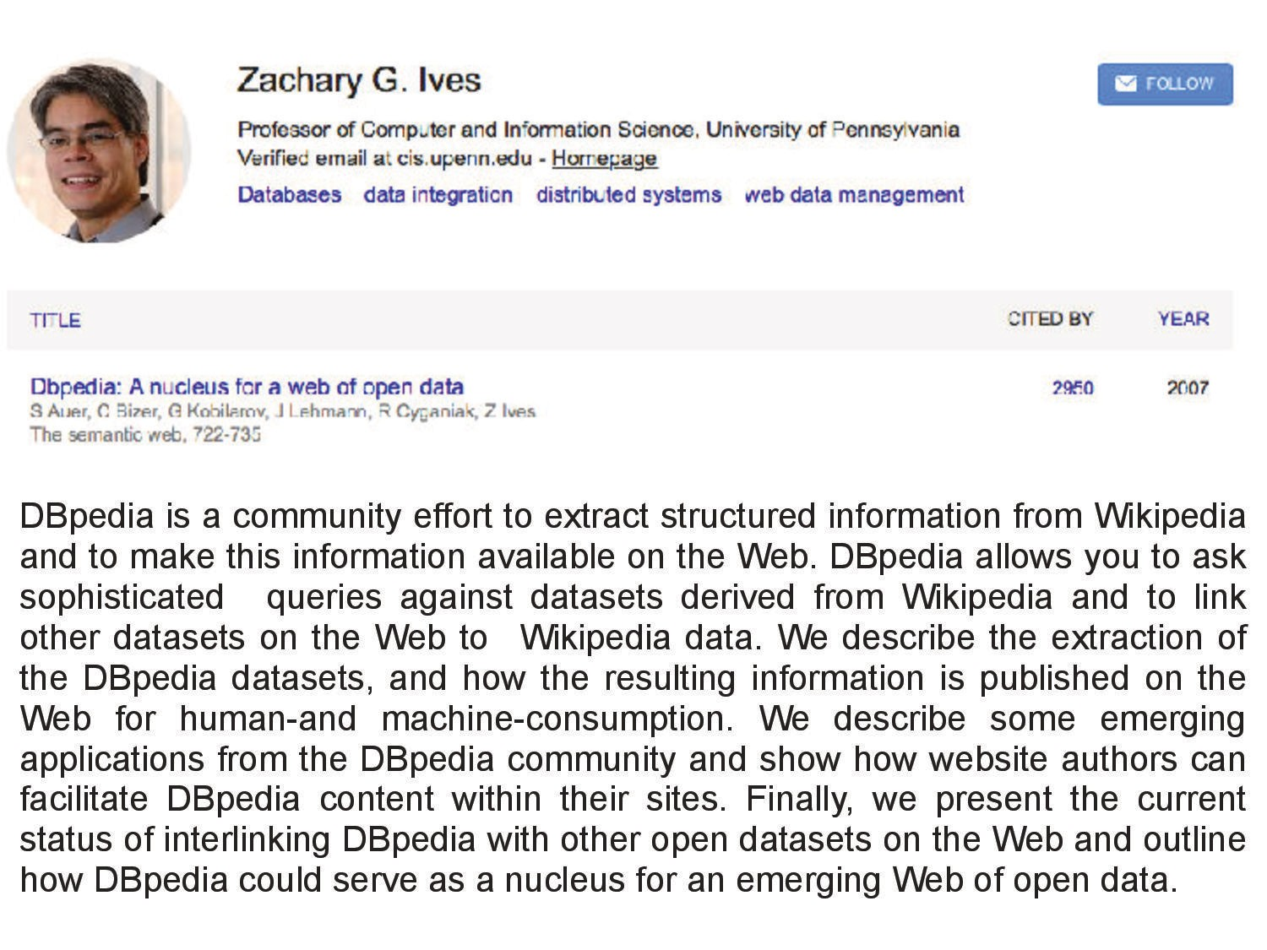

Slide 43
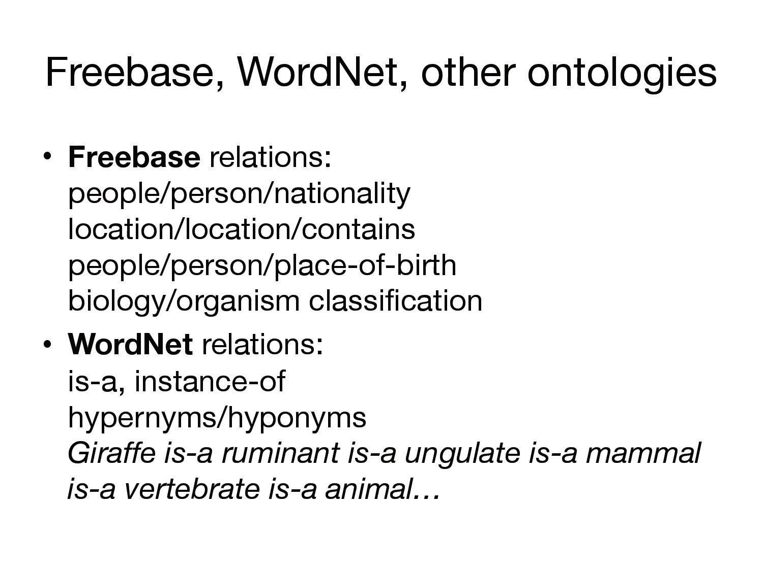

Slide 44
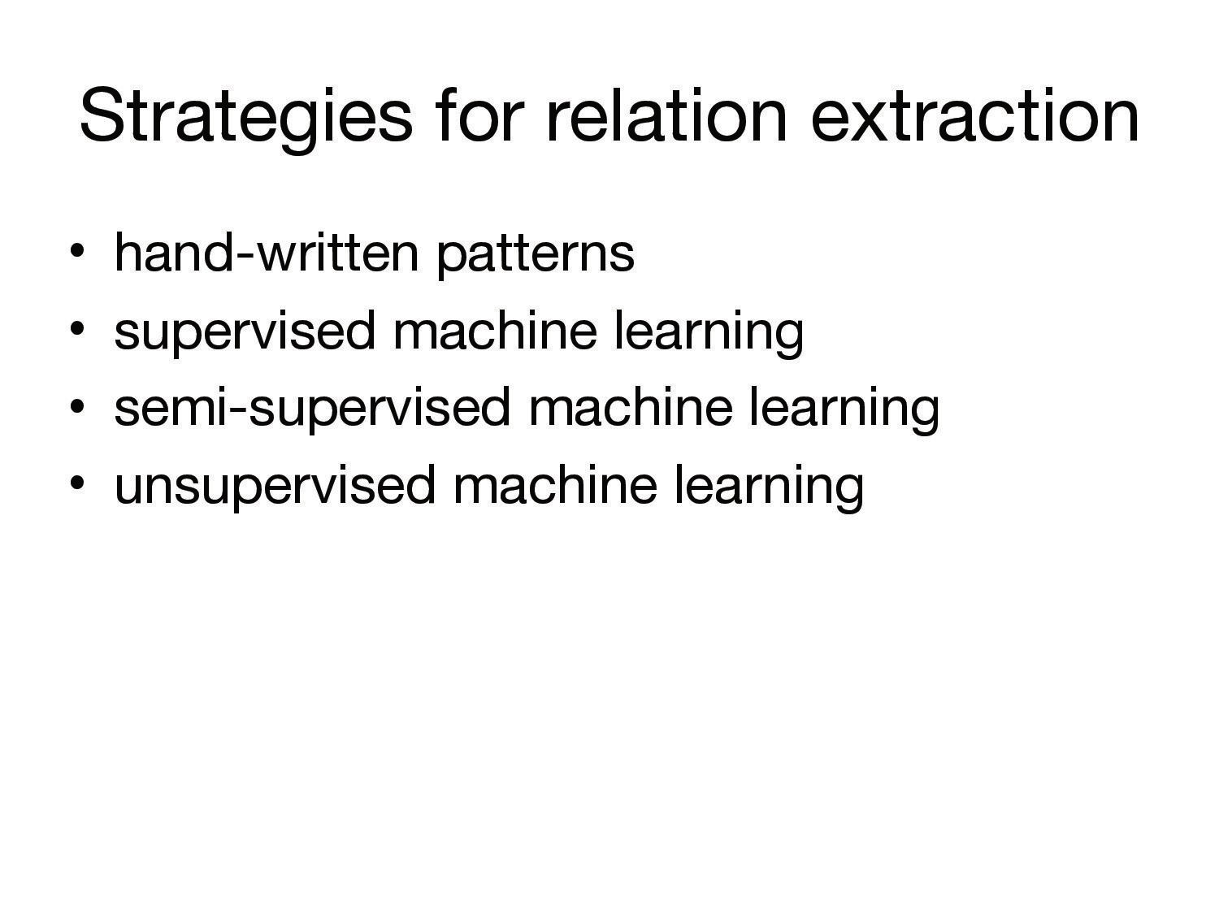

Slide 45
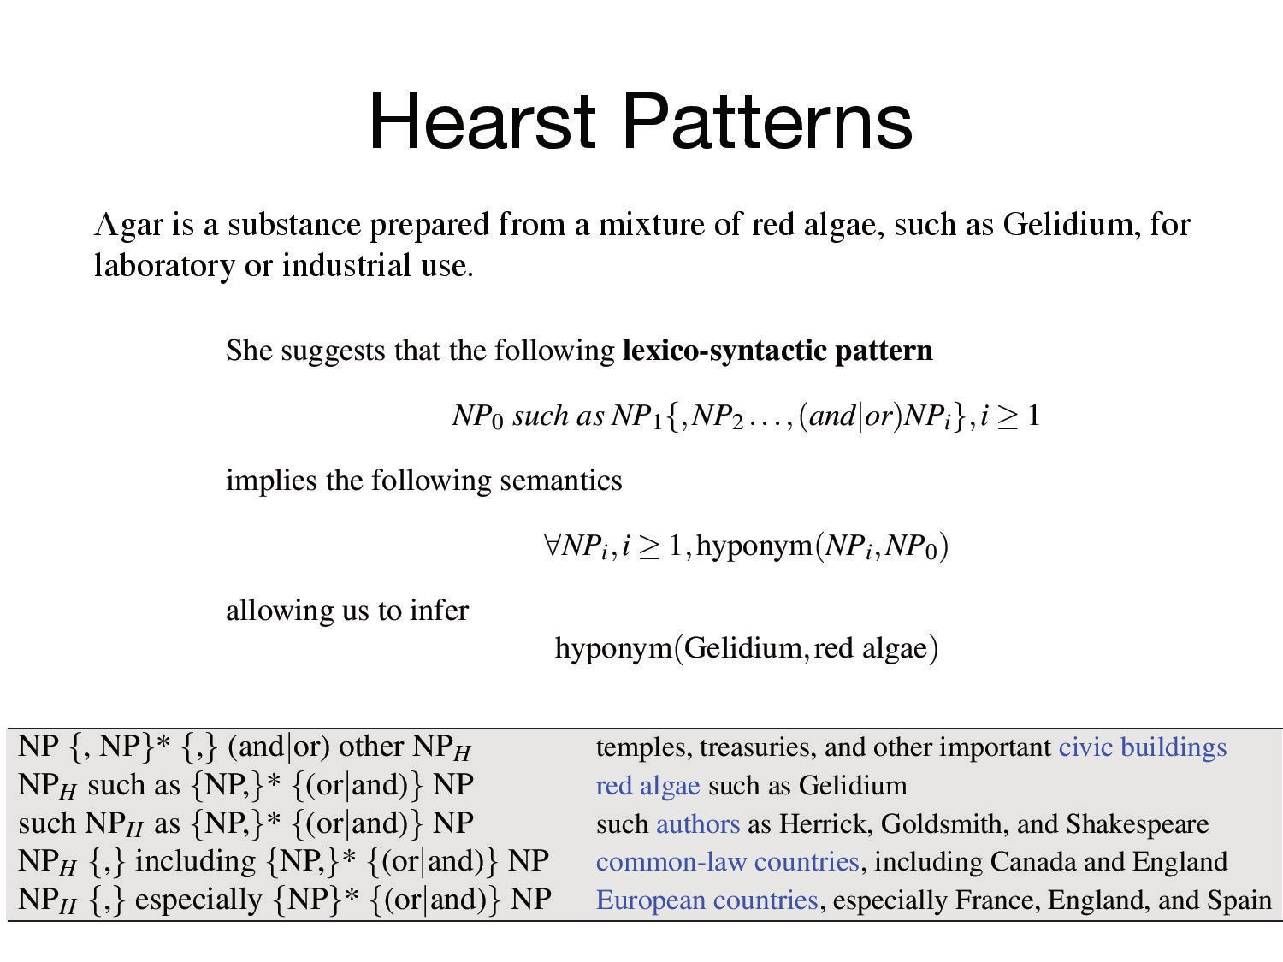

Slide 46
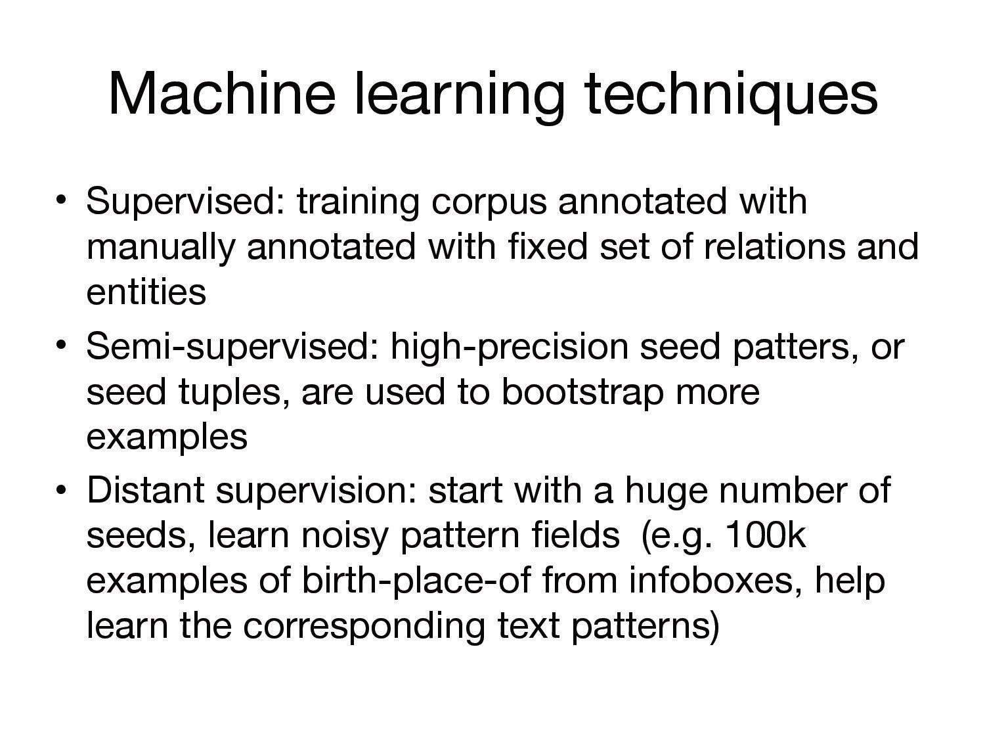

Slide 47
Never Ending Language Learner (NELL) rtw.ml.cmu.edu/
athletePlaysForTeam(athlete, sportsTeam)
“arg1 a player for arg2”, “arg1 travels to arg2”,
“arg1 signs a contract with arg2”
“arg1 signs a contract with arg2”
“arg1 a player for arg2”, “arg1 travels to arg2”,
“arg1 signs a contract with arg2”
“arg1 scored a goal for arg2”
Messi scored a goal for Barcelona
Messi travels to Barcelona
Ronaldo scored a goal for Real Madrid
Ronaldo signs a contract with Real Madrid
Ronaldo scored a goal for charity
Messi a player for Barcelona
(Messi, Barcelona), (Ronaldo, Real Madrid), (Ronaldo, charity)
(Messi, Barcelona), (Ronaldo, Real Madrid), (Ronaldo, charity)
(Messi, Barcelona), (Ronaldo, Real Madrid)
Carlson et al, WSDM 2010; Mitchell et al, AAAI 2015
Notes:
NELL’s coupled pattern learner (CPL) learns to extract more instances of knowledge base relations in a semi supervised manner.
For the relation athletePlaysTeam which takes an entity of type athlete as argument1 and an entity of type sportsTeam as argument2, given a seed pattern for the relation such as “arg1 scored a goal for arg2”, CPL extract candidate instances for this relation from Web text, which are the noun-phrase pairs that co-occur with this seed pattern.
The candidate instances are then filtered using type-checking and mutual exclusion constraints to make sure their types match the relation’s types and that the candidates occur more frequently with the seed patterns of athletePlaysForTeam than with the seed patterns of other relations that are mutually exclusive with the relation athletePlaysForTeam
The remaining instances that co-occur frequently enough with the seed patterns are then promoted as instances of the relation.
CPL then use these newly promoted instances to extract candidate patterns for the relation from the Web text.
It uses a bunch of heuristics to extract word-patterns that co-occur in between the noun-phrase pairs of the instances.
Filtering is done again to filter candidate patterns and promote them.
The learning cycle then begins again with the newly promoted patterns added to the seed patterns.

Slide 48
Never Ending Image Learner (NEIL) www.neil-kb.com/
Chen et al, ICCV 2013
Notes:
In the same spirit as NELL, a visual knowledge base called NEIL was created to automatically extract visual knowledge from the Web.
It uses semi supervised learning to discover common sense relationships, categories, and attributes of Web visual data.
NEIL starts with an ontology of categories and relations and seed the categories with images obtained using Google image search. It then trains object detectors to recognize objects in images. Based on the trained detectors, it detects objects in images and classify their relationships into “part-of” relation or ”is-a” relation, or “similarity” relation based on features like their relative locations, relative aspect ratio, relative scores and relative size of the detections.
Starting from the initial set of classifiers/detectors and the set of relationships, NEIL uses them to find new instances of different objects and scene categories. These new instances are then added to the set of labeled data and we retrain new classifiers/detectors using the updated set of labeled data. These new classifiers are then used to extract more relationships which in turn are used to label more data and so on.
One way to find new instances is directly using the detector itself. For instance, using the car detector to find more cars. Why do you even bother about relations? However, this approach leads to semantic drift; something that is not a car but visually looks like a car maybe labeled as a car. For example, a cloud that is shaped like a car, or a car’s shadow. To avoid semantic drift, NEIL uses the rich set of relationships we extracted in the previous section and ensure that the new labeled instances of car satisfy the extracted relationships (e.g., has wheels, found in raceways etc)
For example, the nose-face relationship is characterized by low relative window size (nose is less than 20% of face area) and the relative location that nose occurs in center of the face. This is used to define a compatibility function which evaluates if the detections from category i and j are compatible or not.

Slide 49
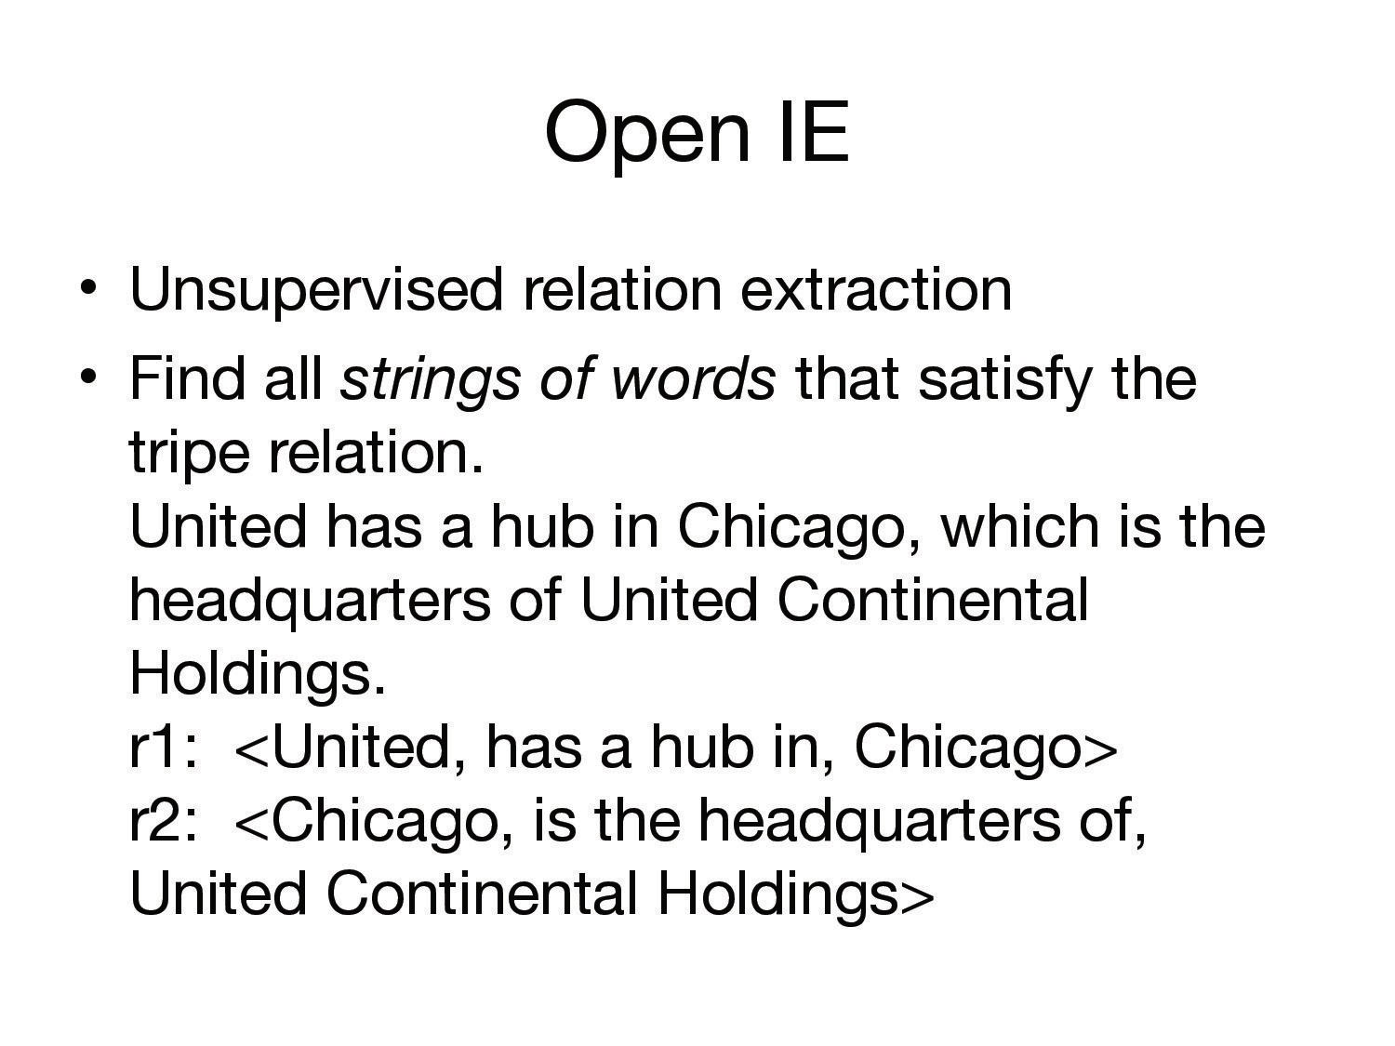

Slide 50
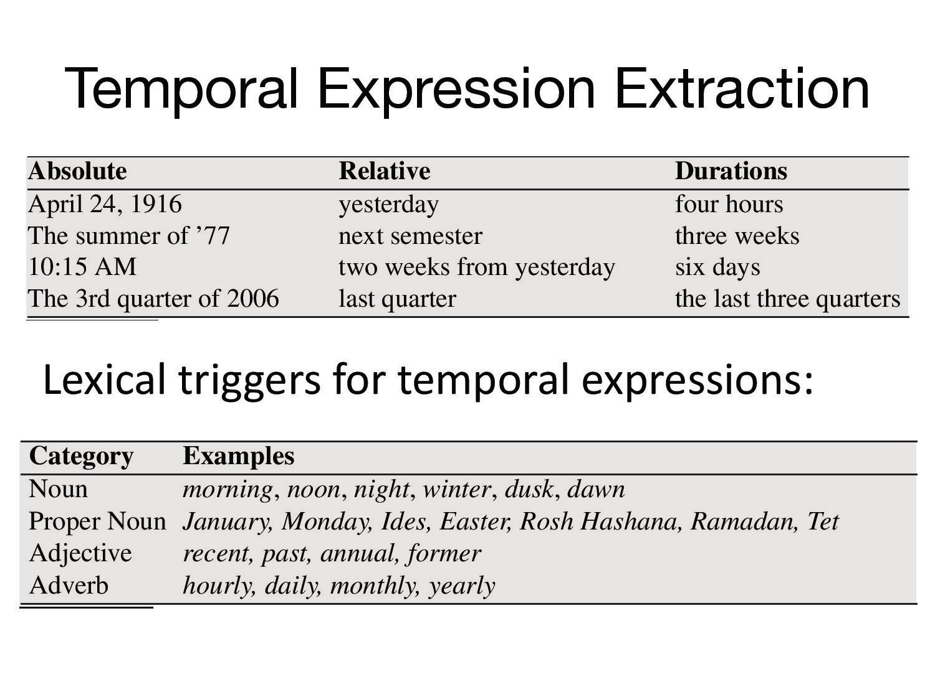

Slide 51
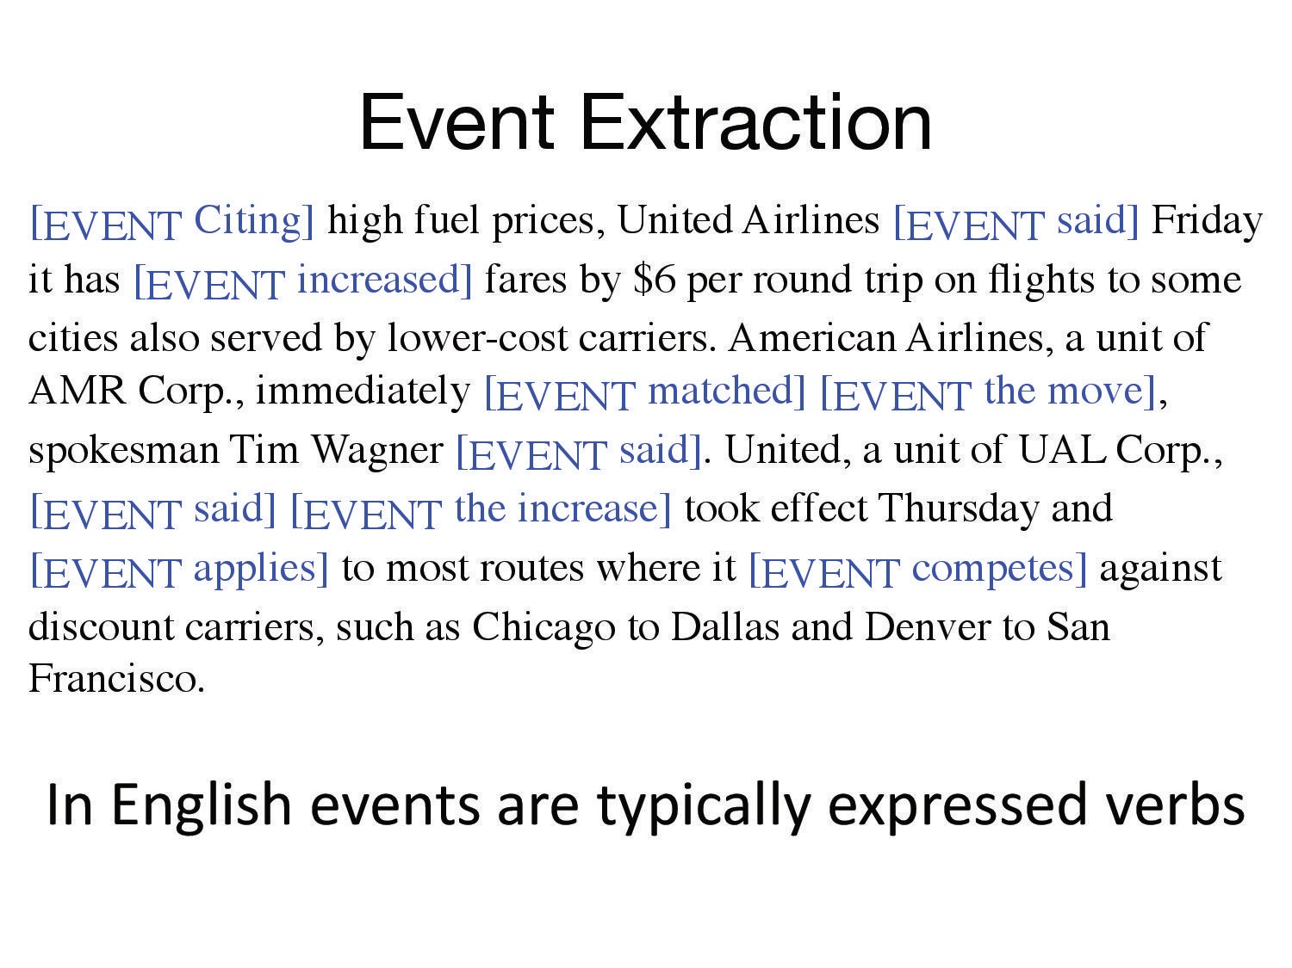

Slide 52
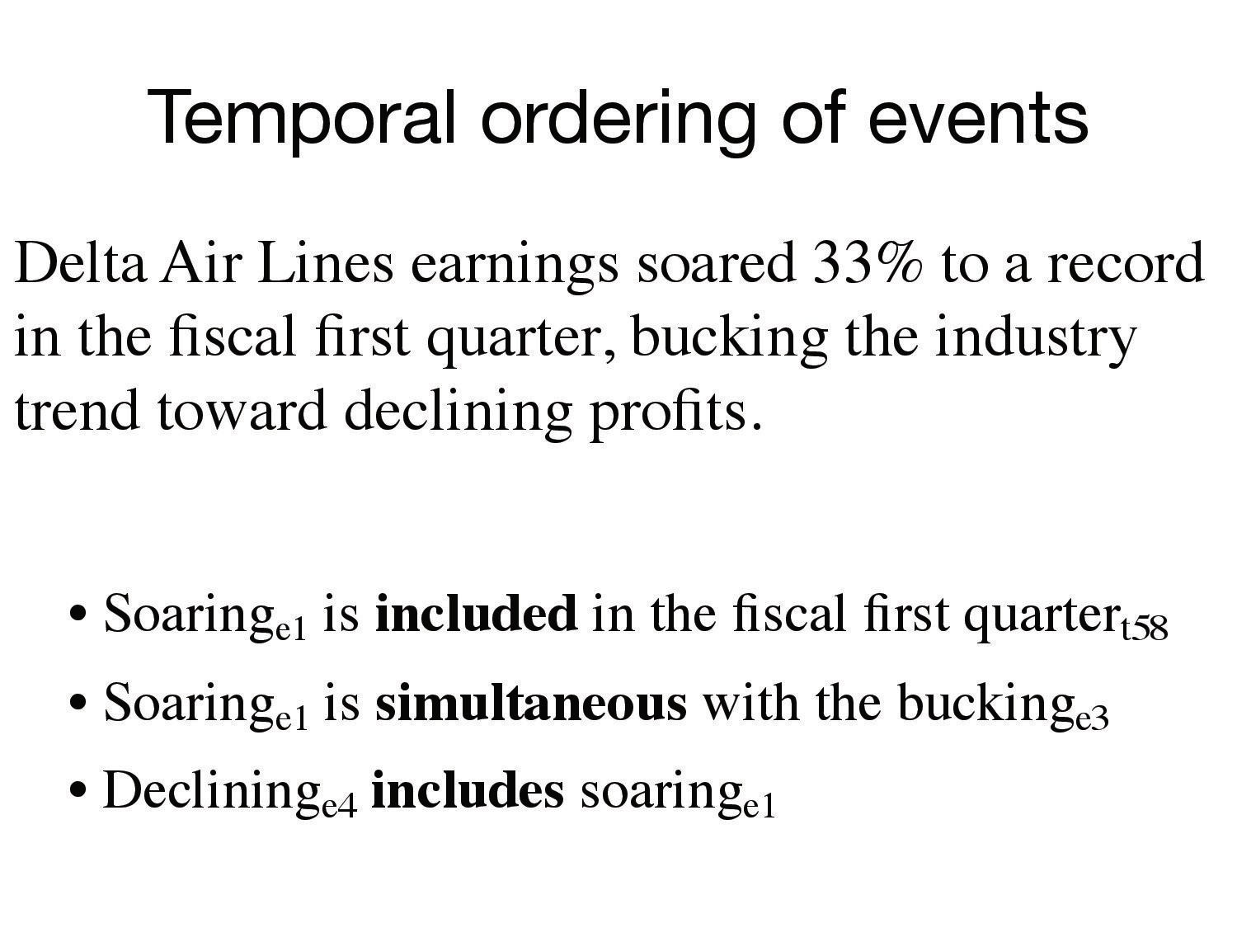

Slide 53
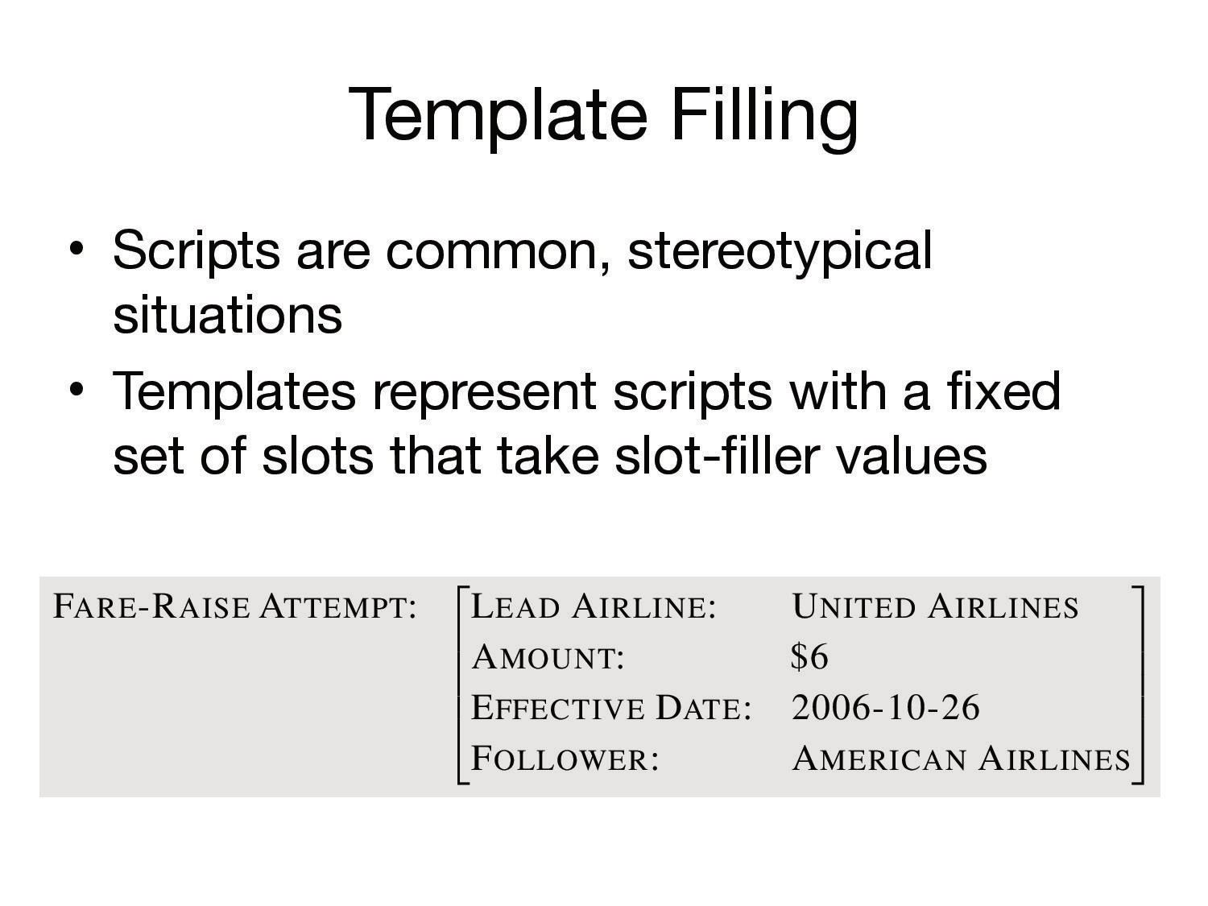

Slide 54
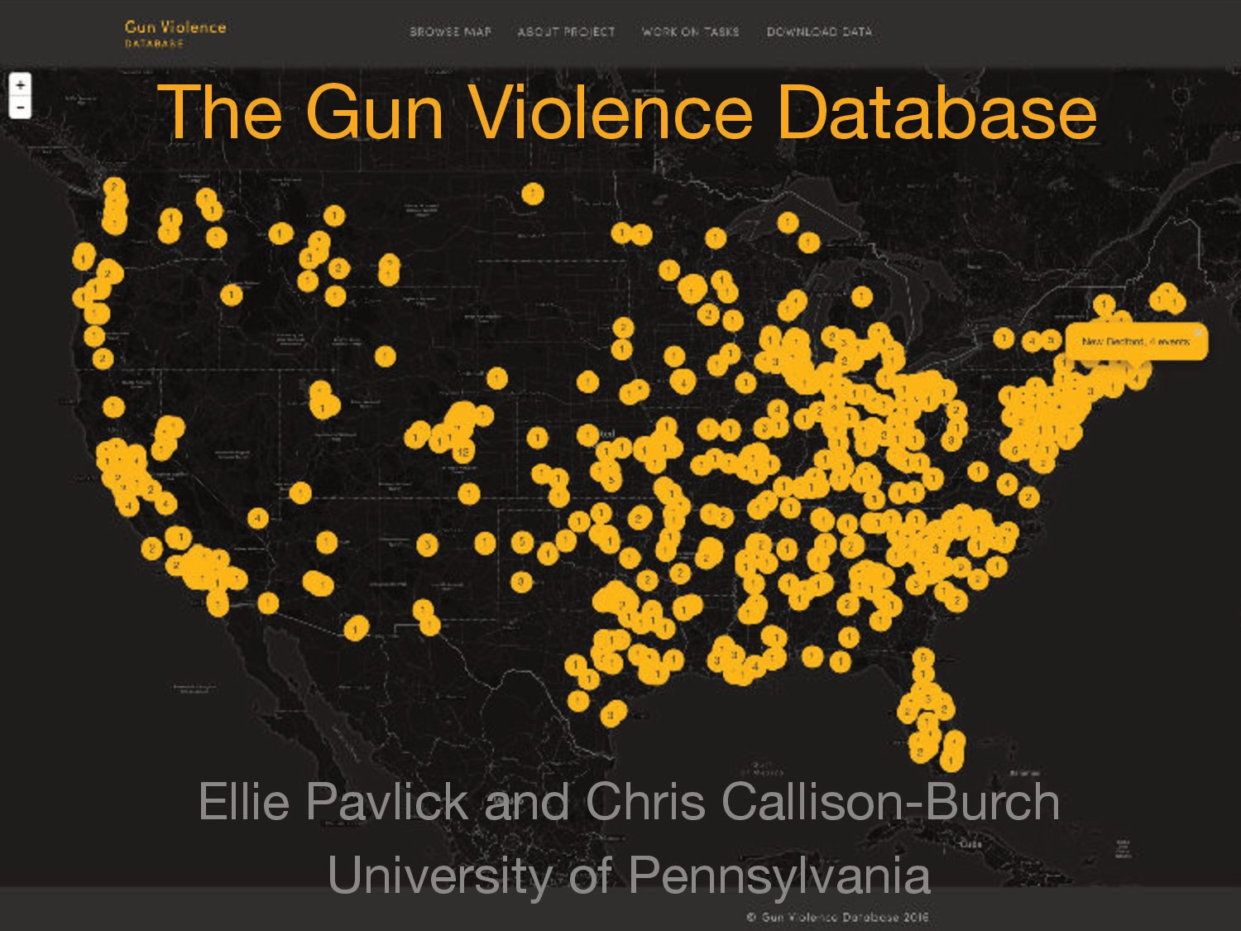

Slide 55
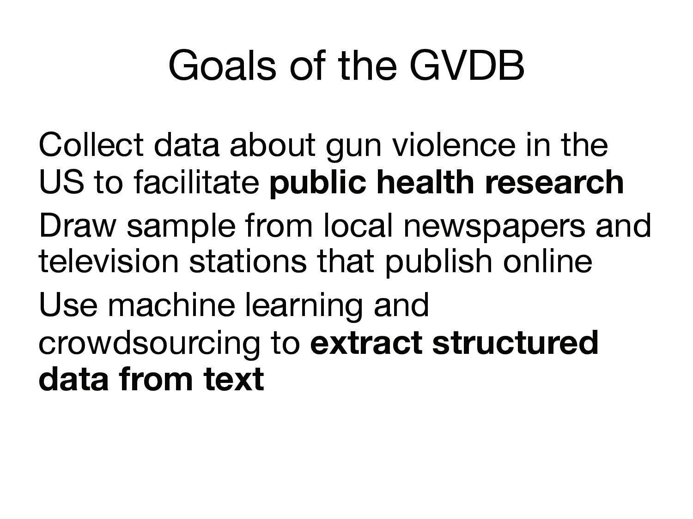

Slide 56
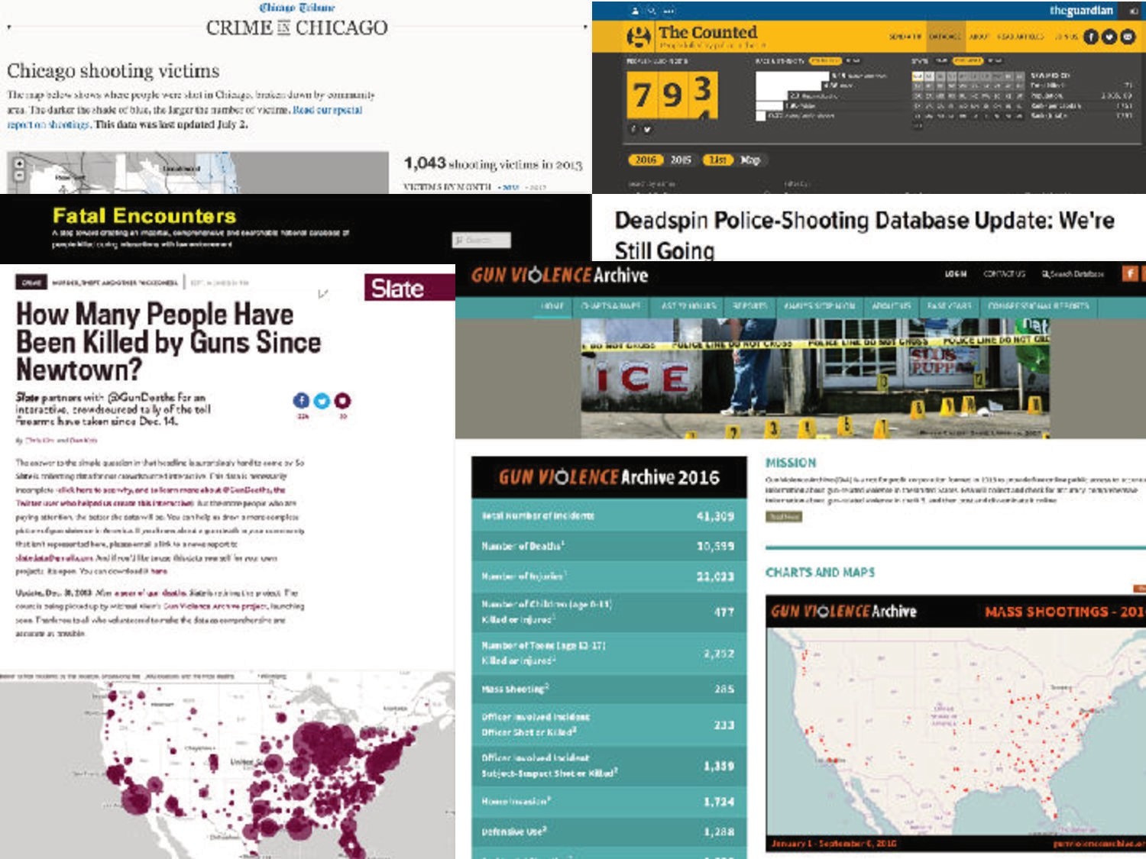

Slide 57
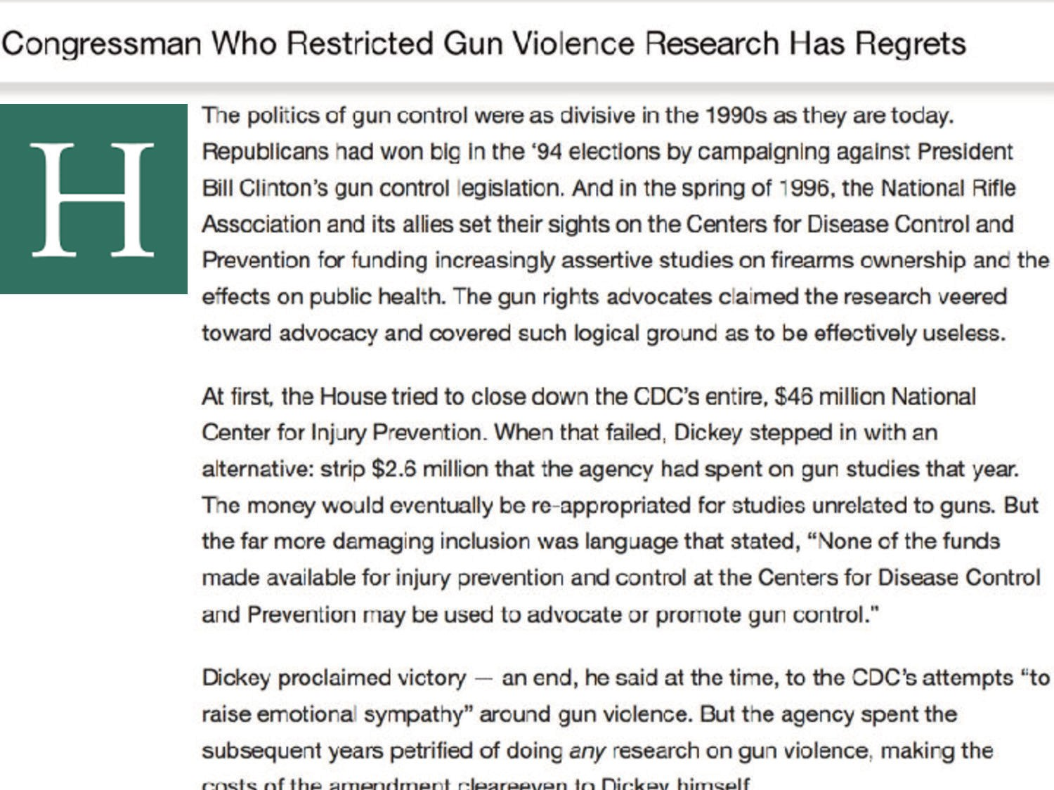

Slide 58


Slide 59
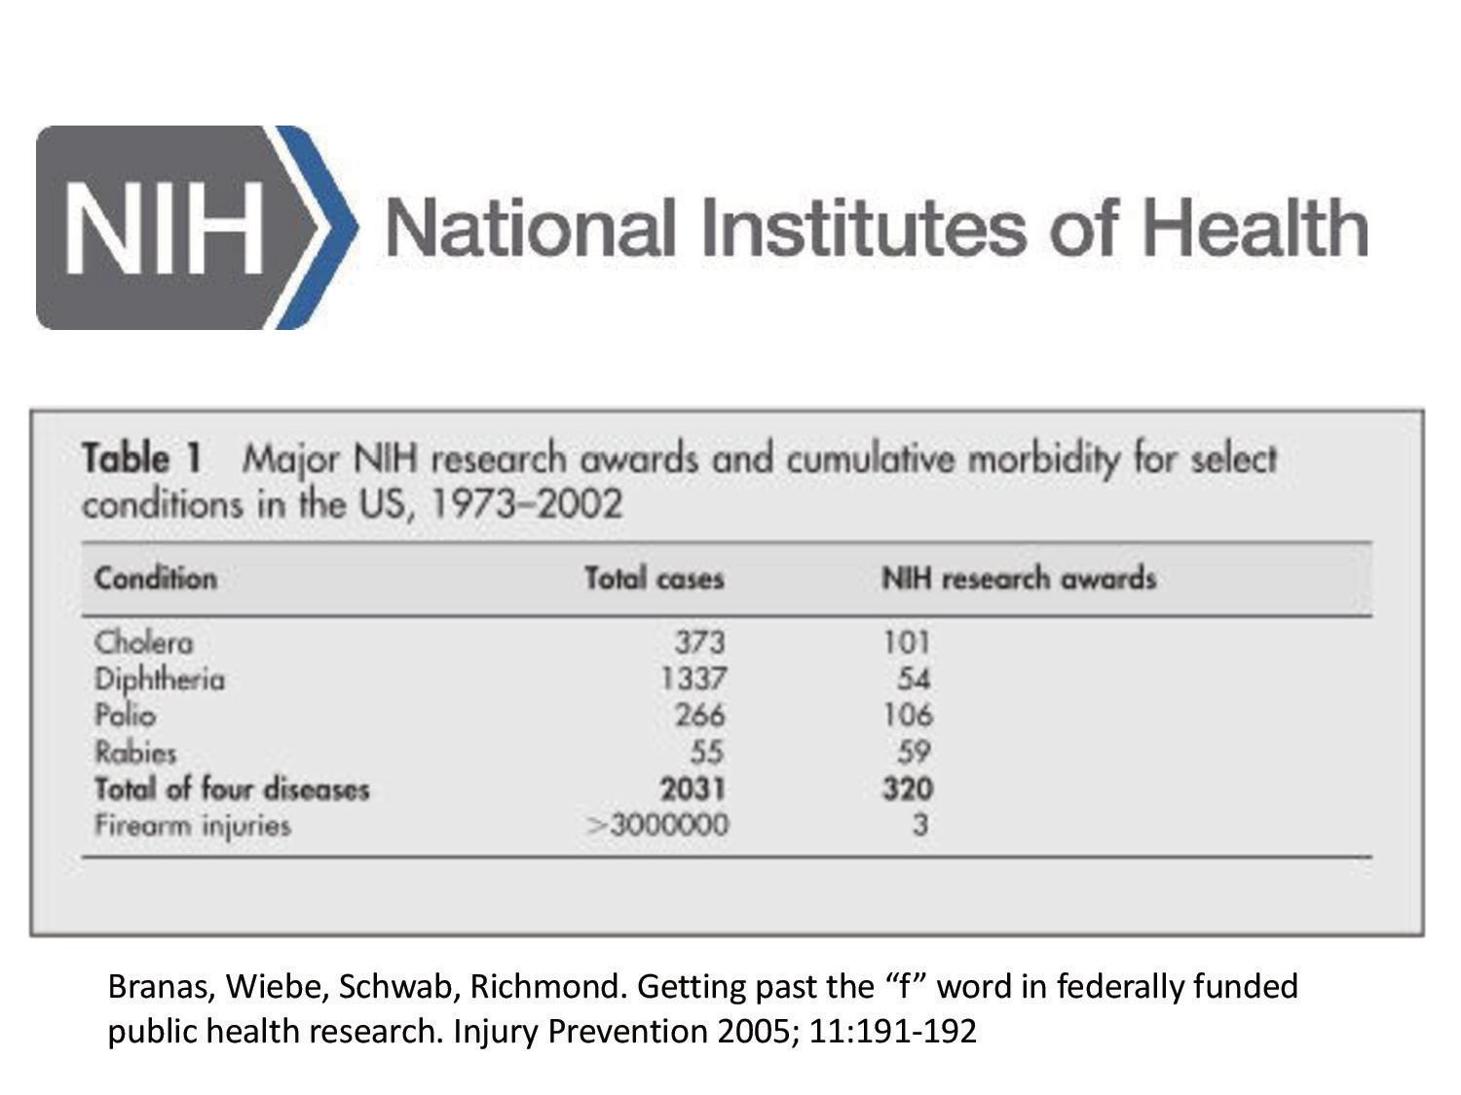

Slide 60
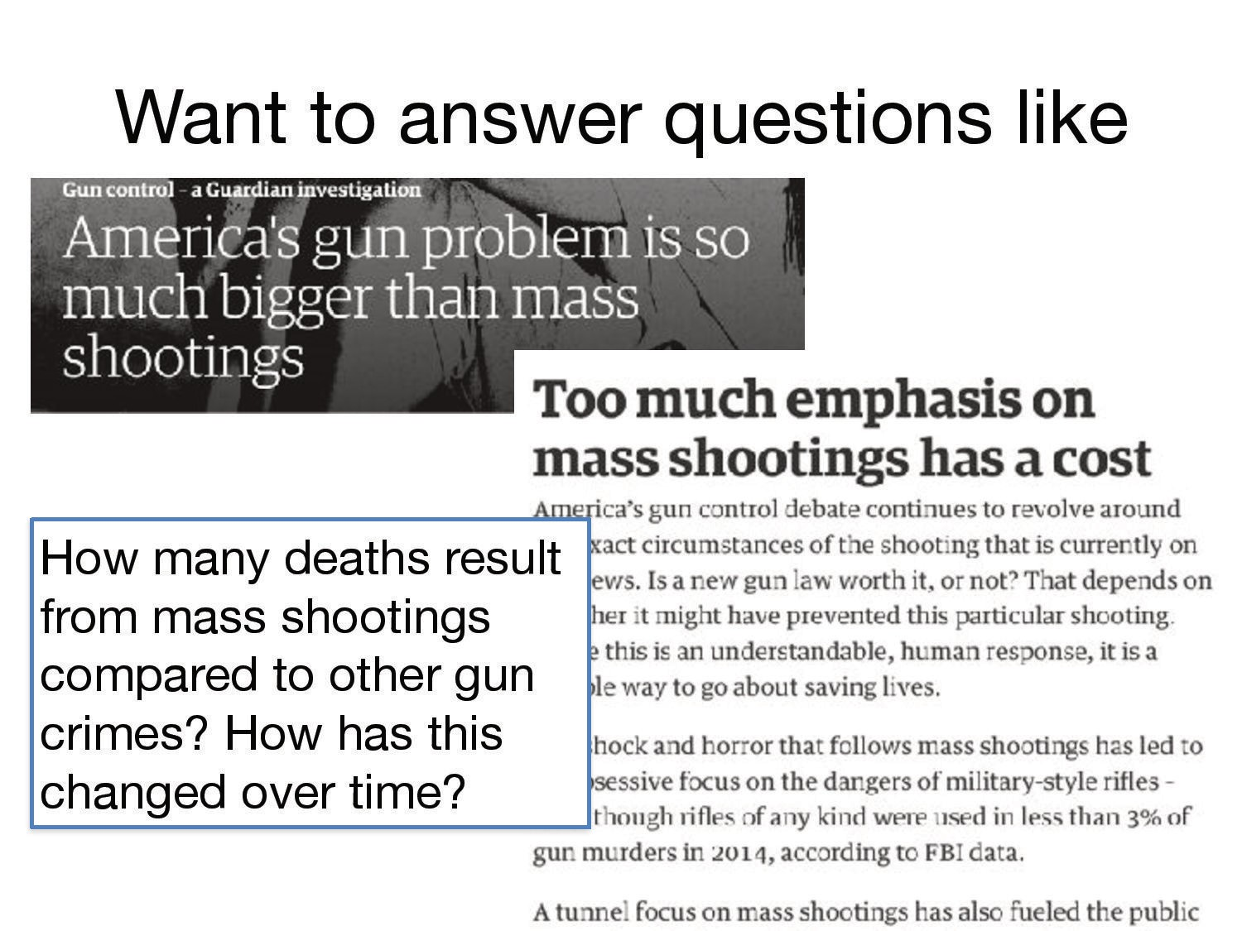

Slide 61
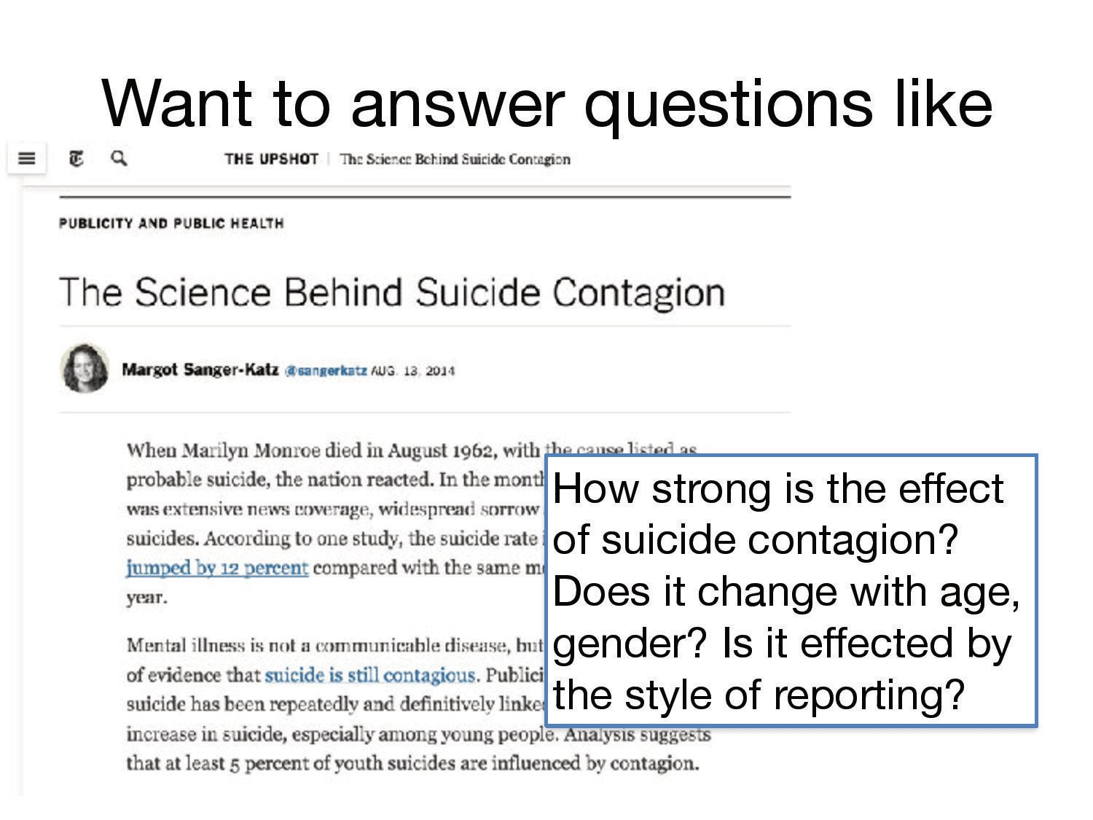

Slide 62
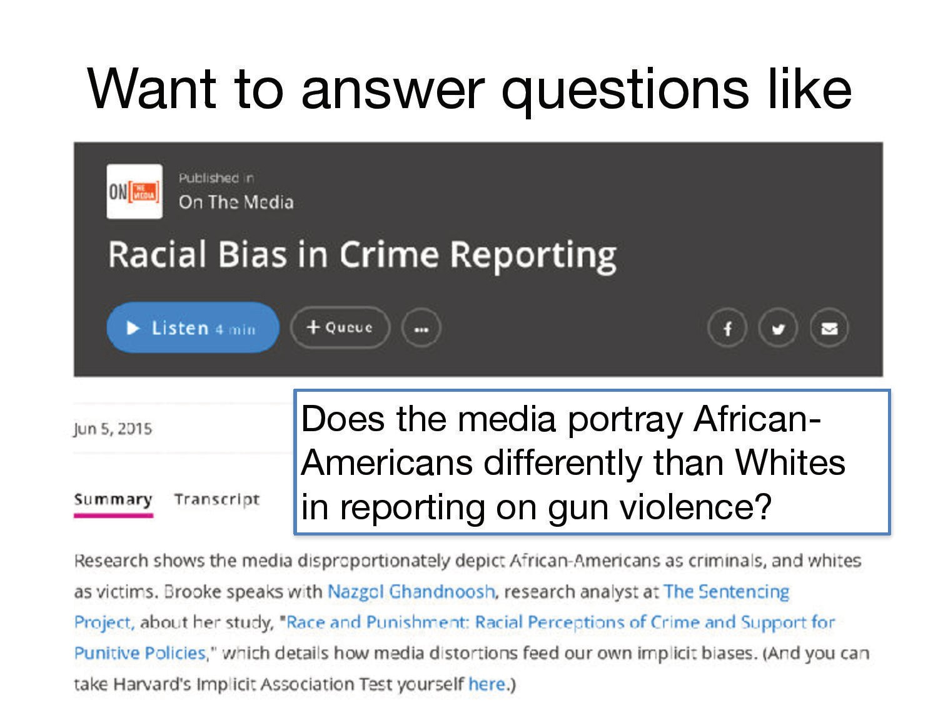

Slide 63
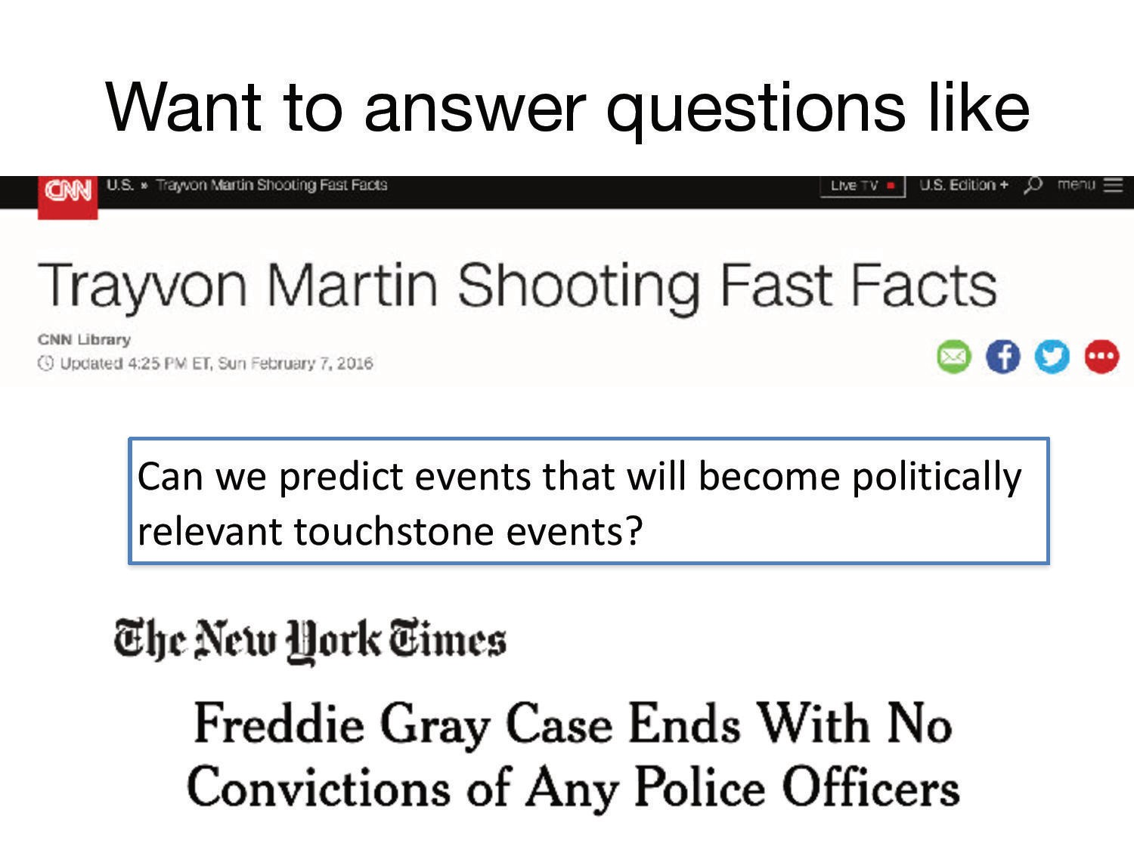

Slide 64


Slide 65


Slide 66


Slide 67


Slide 68


Slide 69



Slide 70


Slide 71



Slide 72



Slide 73


Slide 74


Slide 75


Slide 76


Slide 77


Slide 78


Slide 79


Slide 80


Slide 81


Slide 82


Slide 83


Slide 84


Slide 85


Slide 86


Slide 87


Slide 88



Slide 89



Slide 90


Slide 91


Slide 92
Incorporating Knowledge in Understanding
Ellie Pavlick’s Thesis, 2017
Notes:
Given all the knowledge we have and can gather, an active research question is how can we effectively incorporate knowledge in language understanding systems.

Slide 93

Conclusion
Knowledge is crucial
Symbolic and/or distributional knowledge
Inference over knowledge
Many remaining open research questions
What knowledge to represent?
How to represent it?
How to incorporate knowledge in understanding?
Notes:
Knowledge is crucial for building intelligent machines capable of understanding
We can gather this knowledge symbolically or distributionally or both
We can do inference over the collected knowledge
Many remaining open research questions that we still need to answer and new exciting projects and products that try to answer these questions.

